Slide 1
Module 4: Implement the DiffServ QoS Model
Lesson 4.5: Configuring CBWFQ and LLQ

Slide 2
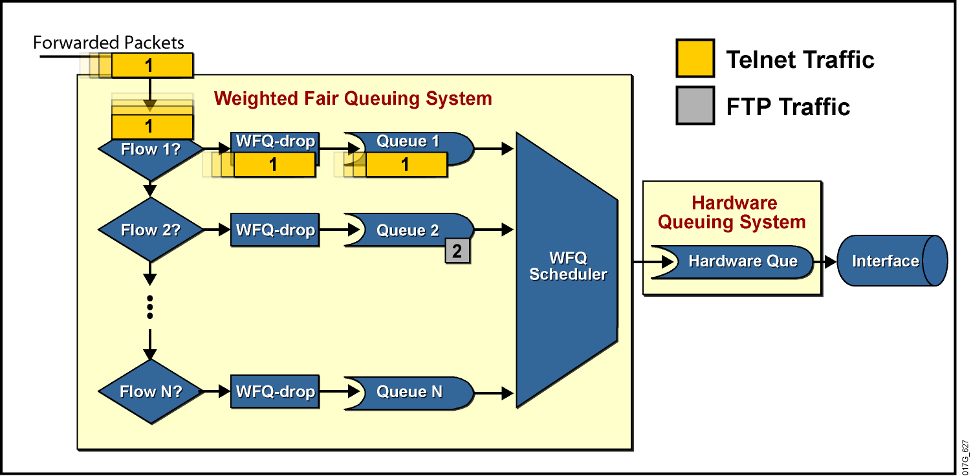
Weighted Fair Queueing
WFQ sa snaží plánovať obsluhu frontov tak, aby každým pretieklo za istý čas to isté množstvo dát
WFQ automaticky roztrieďuje jednotlivé konverzácie (toky) do frontov
Notes:
WFQ is a dynamic scheduling method that provides fair bandwidth allocation to all network traffic. WFQ applies weights to identified traffic, classifies traffic into flows, and determines how much bandwidth each flow is allowed, relative to other flows.
The WFQ method works as the default queuing mode on serial interfaces configured to run at or below E1 speeds (2.048 Mbps).
WFQ provides the solution for situations in which it is desirable to provide consistent response times to heavy and light network users alike, without adding excessive bandwidth. In addition, WFQ can manage duplex data flows, such as those between pairs of applications, and simplex data flows, such as voice or video.
Although WFQ automatically adapts to changing network traffic conditions, it does not offer the precise degree of control over bandwidth allocation that custom queuing (CQ) and class-based weighted fair queuing (CBWFQ) offer.
The significant limitation of WFQ is that it is not supported with tunneling and encryption because these features modify the packet content information required by WFQ for classification.

Slide 3
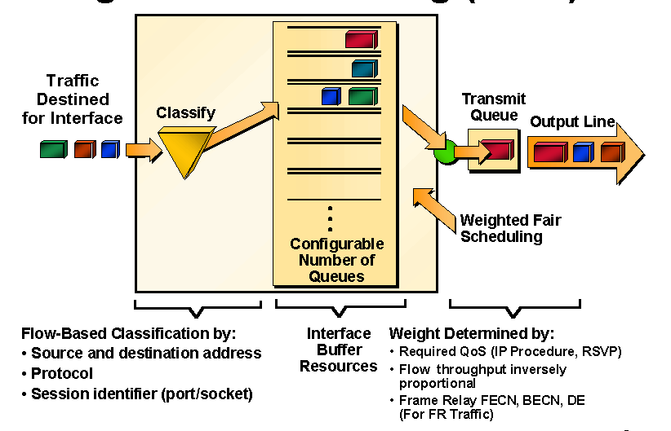
Prehľad činnosti WFQ
Notes:
For situations in which it is desirable to provide consistent response time to heavy and light network users alike without adding excessive bandwidth, the solution is Weighted Fair Queuing (WFQ). WFQ uses a flow-based queuing algorithm that does two things simultaneously:
It schedules interactive traffic to the front of the queue to reduce response time.
It fairly shares the remaining bandwidth among the various flows to prevent high-volume flows from monopolizing the outgoing interface.
The basis of WFQ is to have a dedicated queue for each flow without starvation, delay, or jitter within the queue. Furthermore, WFQ allows fair and accurate bandwidth allocation among all flows with minimum scheduling delay. WFQ makes use of the IP precedence bits as a weight when allocating bandwidth. Low-volume traffic streams, which comprise the majority of traffic, receive preferential service, transmitting their entire offered loads in a timely fashion. High-volume traffic streams share the remaining capacity proportionally between them.

Slide 4
Výhody a nevýhody WFQ
Weighted Fair Queueing je mechanizmus, ktorý sa až na zopár vlastností (maximálny počet paketov v systéme a prahová hodnota zahadzovania) nenastavuje
Je vhodný pre bežné nenáročné situácie, ak je potrebné, aby všetko „išlo rovnako dobre“, prípadne „všetko rovnako zle“
Je vhodný pre automatizovanú obsluhu tokov, ktoré sme my ako administrátori do separátnych tried nerozdelili, no chceme predsa medzi nimi diferencovať
Nie je však vhodný pre situácie, keď my potrebujeme stanoviť, čo je dôležitejšie a čo menej
Aplikovateľnosť WFQ na veľké objemy prevádzky s veľkým množstvom konverzácií je otázna – vysoká výpočtová náročnosť
WFQ je však základom mechanizmu, ktorý sa konfiguruje v MQC – tzv. Class-Based WFQ

Slide 5
Class-Based Weighted Fair Queuing
CBWFQ je mechanizmus, ktorý má garantovať pásmo jednotlivým triedam
CBWFQ rozširuje štandardné WFQ o podporu používateľsky definovaných tried prevádzky
Triedy sú identifikované na základe class-map
Pre každú triedu je vyhradený jeden konverzačný front a doň je umiestňovaná prevádzka patriaca do danej triedy
Váha pre jednu triedu je vypočítaná ako podiel
InterfaceBandwidth/ClassBandwidth
Notes:
CBWFQ extends the standard WFQ functionality to provide support for user-defined traffic classes. With CBWFQ, the user defines the traffic classes based on match criteria, including protocols, ACLs, and input interfaces. Packets satisfying the match criteria for a class constitute the traffic for that class. A queue is reserved for each class, and traffic belonging to a class is directed to that class queue.
After a class has been defined and its match criteria have been formulated, you can assign characteristics to the class. To characterize a class, you assign a bandwidth and a maximum packet limit to it. The bandwidth assigned to a class is the minimum bandwidth delivered to the class during congestion.
To characterize a class, you also specify the queue limit for that class, which is the maximum number of packets allowed to accumulate in the class queue. The queuing guarantees the minimum bandwidth, but also gives a class unlimited access to more bandwidth if more is available. After a queue has reached its configured queue limit, enqueuing of additional packets to the class causes tail drop or random packet drop, depending on how the class policy is configured. You can configure up to 64 discrete classes in a service policy.

Slide 6
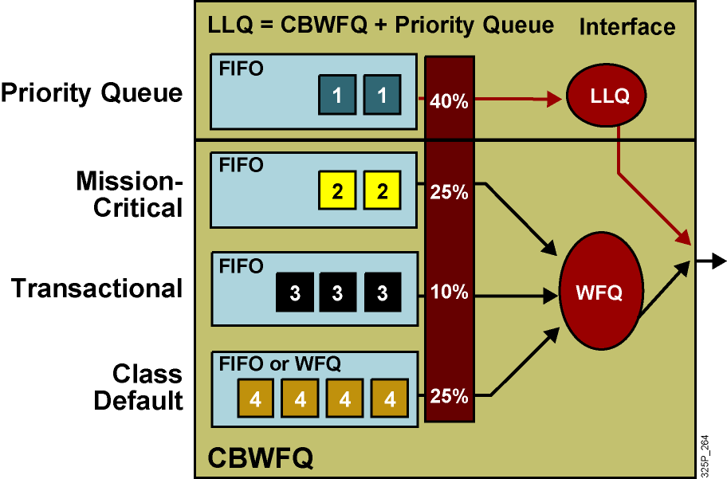
Class Based Weighted Fair Queueing
Notes:
Neither the basic queuing methods nor the more advanced weighted fair queuing (WFQ) methods completely solve the quality of service (QoS) problems resulting from converged network traffic. The following problems remain:
If only a priority queue is used for a voice-enabled network, voice gets the needed priority. However, data traffic would suffer.
If only custom queuing (CQ) is used for a voice-enabled network, data traffic is assured of some bandwidth. However, voice traffic would suffer delays.
If WFQ is used, voice still experiences delay even when treated “fairly” by WFQ.
In PQ and CQ, all of the classification, marking, and queuing mechanisms are complicated to use and time-consuming when applied on an interface-by-interface basis.
Newer queuing mechanisms combine the best aspects of existing queuing methods. Low latency queuing (LLQ) is a combination of class-based weighted fair queuing (CBWFQ), which assigns weights according to bandwidth, and a priority system based on class that gives voice the priority it requires while ensuring that data is serviced efficiently. This solves the potential starvation problem of the priority queue by including a policing function based on the configured bandwidth of the priority system.

Slide 7
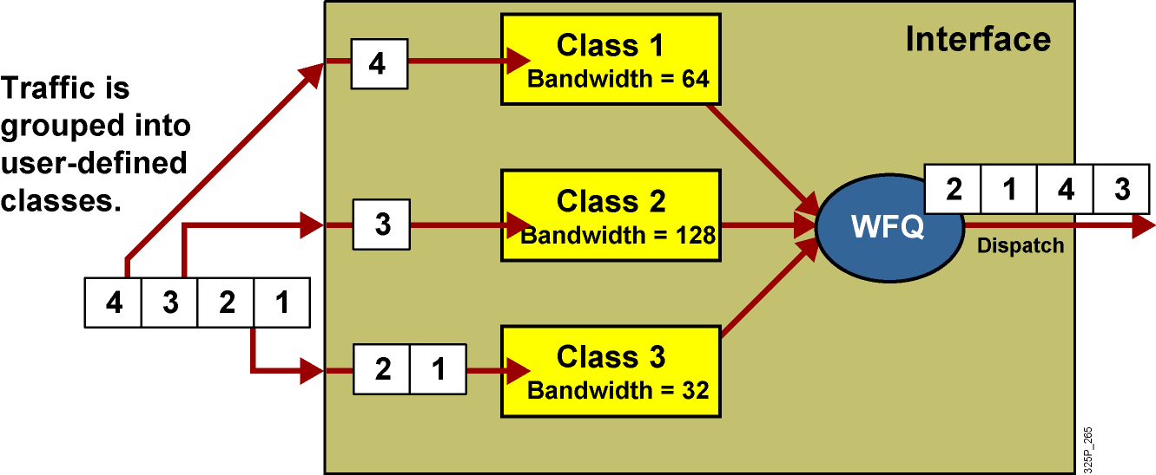
Architektúra CBWFQ
Notes:
CBWFQ supports multiple class maps to classify traffic into its corresponding FIFO queues.
CBWFQ classes use tail drop unless you explicitly configure a policy for a class to use weighted random early detection (WRED) to drop packets as a means of avoiding congestion. Note that if you use the WRED packet drop instead of tail drop for one or more classes in a policy map, you must ensure that WRED is not configured for the interface to which you attach that service policy.
Serial interfaces at E1 (2.048 Mbps) and below use WFQ by default—other interfaces use FIFO by default. Enabling CBWFQ on a physical interface overrides the default interface queuing method.
Be cautious when configuring CBWFQ on ATM interfaces. Enabling CBWFQ on an ATM permanent virtual circuit (PVC) does not override the default queuing method. Unspecified bit rate (UBR) connections do not support CBWFQ.

Slide 8
Plánovací mechanizmus v CBWFQ
CBWFQ garantuje prenosové pásmo jednotlivým triedam
Váhy jednotlivých tried sú interne vypočítané na základe pásma prideleného danej triede a celkového pásma na rozhraní
Pridelené pásmo môže byť dané pomocou:
Príkazu bandwidth (kbps), nemôže prekročiť hodnotu
InterfaceBandwidth * MaxReservedBandwidth
Percent pásma (bandwidth percent), nemôže prekročiť hodnotu
MaxReservedBandwidth
Percentami zostávajúceho pásma (bandwidth remaining percent), pričom zostávajúce pásmo je dané vzťahom
InterfaceBandwidth * MaxReservedBandwidth – Priority
V jednej policy-map nie je možné tieto spôsoby kombinovať
Všetky triedy majú mať konzistentné jednotky, t.j. všetky sú bandwidth, alebo všetky sú bandwidth percent, alebo všetky sú bandwidth remaining percent
Trieda priority môže byť vždy zadaná v iných jednotkách
Notes:
The CBWFQ mechanism calculates weights based on the available bandwidth. These weights are then used by the CBWFQ scheduling mechanism to dispatch the packets. You can configure bandwidth guarantees by using one of the following commands:
The bandwidth command allocates a fixed amount of bandwidth by specifying the amount in kilobits per second. The reserved bandwidth is subtracted from the available bandwidth of the interface where the service policy is used. The allocated bandwidth must also be within the configured reservable limit (75 percent of interface bandwidth by default).
The bandwidth percent command can be used to allocate a percentage of the total available bandwidth of an interface. The total interface bandwidth is defined by using the bandwidth interface command. It is recommended that the bandwidth command reflect the real speed of the link. The allocated bandwidth is subtracted from the available bandwidth of the interface where the service policy is used.
The bandwidth remaining percent command is used to allocate the amount of guaranteed bandwidth based on a relative percentage of available bandwidth. When the bandwidth remaining percent command is configured, hard bandwidth guarantees may not be provided, and only relative per-class bandwidths are assured.
A single service policy cannot mix the bandwidth (fixed, in kilobits per second) and bandwidth percent commands (except with strict-priority queues).

Slide 9
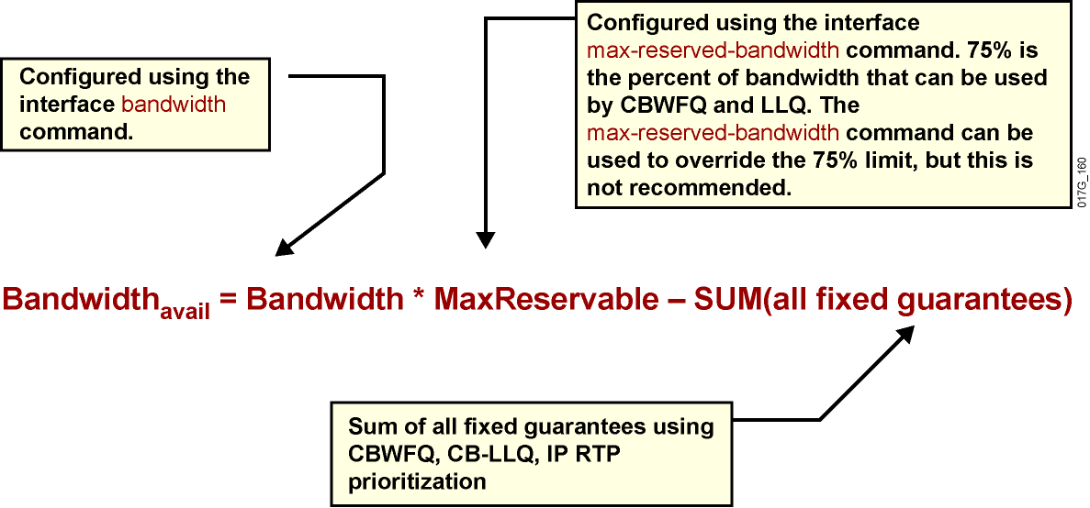
Rezervovateľné pásmo
Notes:
The available bandwidth displayed by the show interface command is calculated by subtracting all fixed bandwidth reservations from the default 75 percent of the configured bandwidth of an interface.
The available bandwidth is calculated with the following formula as shown.
You can calculate the required bandwidth by adding the bandwidth requirements for each major application (for example, voice, video, and data). The resulting sum represents the minimum bandwidth requirement for any given link, and it should not exceed 75 percent of the total available bandwidth for the link. The remaining 25 percent is used for other overhead.
You can override the 75 percent maximum sum allocated to all classes or flows using the max-reserved-bandwidth command. If you want to override the default 75 percent, exercise caution and ensure that you allow enough remaining bandwidth to support best-effort and control traffic and Layer 2 overhead such as Layer 2 keepalive messages, as well as the class default traffic.
If all of the bandwidth is not allocated, the remaining bandwidth is proportionately allocated among the classes based on the configured bandwidth of the classes.

Slide 10
Výhody a nevýhody CBWFQ
Výhody | Triedy definované podľa individuálnych potrieb Garancia minimálneho pásma Dobrá granularita a škálovateľnosť
Nevýhody | Hlasová prevádzka ešte vždy môže byť neprimerane zdržaná
Notes:
CBWFQ allows you to define traffic classes based on custom-defined match criteria such as ACLs, input interfaces, and protocol type.
The benefits and drawback of CBWFQ described as follows:
Classification: CBWFQ allows custom-defined classifications based on many parameters, such as ACLs, input interfaces, byte count, and so on.
Bandwidth allocation: CBWFQ allows you to specify the exact minimum bandwidth to be allocated for a specific class of traffic. Taking into account available bandwidth on the interface, you can configure up to 64 classes and control distribution among them, which is not the case with the flow-based WFQ. Flow-based WFQ applies weights to traffic to classify it into conversations and determines how much bandwidth each conversation is allowed, relative to other conversations. For flow-based WFQ, these weights, and traffic classification, are dependent on and limited to IP precedence levels.
Finer granularity and scalability: CBWFQ allows you to define what constitutes a class based on criteria that exceed the confines of flow. You do not need to maintain traffic classification on a per-flow basis. Moreover, you can configure up to 64 discrete classes in a service policy.
The drawback is that voice traffic can still suffer from unacceptable delays if you use CBWFQ as the only queuing mechanism.

Slide 11
Konfigurácia CBWFQ v policy-map
router(config-pmap-c)#
bandwidth bandwidth
Danej triede pridelí isté minimálne pásmo
Hodnota je v kbps
router(config-pmap-c)#
bandwidth percent percent
Danej triede alokuje isté percento pásma rozhrania
Na výpočet sa berie celé prenosové pásmo rozhrania podľa príkazu bandwidth
router(config-pmap-c)#
bandwidth remaining percent percent
Danej triede alokuje isté percento zo zvyšného (neprideleného) pásma rozhrania (čo zostáva po nerezervovateľnom pásme a priorite)
Notes:
The bandwidth command within the policy-map class configuration command is used to specify or modify the bandwidth allocated for a class belonging to a policy map.
All classes belonging to one policy map should use the same type of bandwidth guarantee, in kilobits per second, percentage of interface bandwidth, or percentage of available bandwidth.
Configuring bandwidth in percentages is most useful when the underlying link bandwidth is unknown or the relative class bandwidth distributions are known.
These restrictions apply to the bandwidth command:
If the percent keyword is used, the sum of the class bandwidth percentages cannot exceed 100 percent.
The amount of bandwidth configured should be large enough to accommodate Layer 2 overhead.
A policy map can have all the class bandwidths specified in kilobits per second or in percentages but not a mix of both. However, the unit for the priority command in the priority class can be different from the bandwidth unit of the low-priority class.

Slide 12
Konfigurácia CBWFQ v policy-map
router(config-pmap-c)#
queue-limit queue-limit
Definuje maximálny počet paketov pre daný konverzačný front patriaci triede
Predvolená hodnota je 64
router(config-pmap-c)#
fair-queue [number-of-dynamic-queues]
Trieda class-default (v nových IOSoch každá trieda) môže byť nastavená, aby využívala klasický WFQ pre svoje toky individuálne
Počet dynamických frontov nie je nevyhnutný, povolené hodnoty sú v mocninách 2 od 16 po 4096
Notes:
The default queue limit of 64 packets can be changed using the queue-limit command. It is recommended that you not change the default value.
The default class can be selected by specifying the class-default name of the class. The default class supports two types of queuing: a FIFO queue (default) or a flow-based WFQ system. Both types can be combined with WRED. A FIFO queue can also get a minimum bandwidth guarantee.

Slide 13
Monitoring CBWFQ
Router#show policy-map interface
FastEthernet0/0
Service-policy output: policy1
Class-map: class1 (match-all)
0 packets, 0 bytes
5 minute offered rate 0 bps, drop rate 0 bps
Match: access-group 101
Queueing
Output Queue: Conversation 265
Bandwidth 3000 (kbps) Max Threshold 30 (packets)
(pkts matched/bytes matched) 0/0
(depth/total drops/no-buffer drops) 0/0/0
<...part of the output omitted...>
Class-map: class-default (match-any)
0 packets, 0 bytes
5 minute offered rate 0 bps, drop rate 0 bps
Match: any
Queueing
Flow Based Fair Queueing
<...rest of the output omitted...>
Notes:
the show policy-map interface command displays all service policies applied to the interface.
As an example, a policy including policing parameters, queuing mechanism, bandwidth and statistics is applied on the FastEthernet 0/0 interface. The class1 class map classifies any traffic matched by ACL 101 as CBWFQ. Also, bandwidth of 3000 kbps is displayed. Traffic not matching the configured classification (class1 and class2) will be placed in the class-default class map.

Slide 14
Low Latency Queuing (LLQ)
Pod názvom Low Latency Queueing sa skrýva kombinácia prioritných frontov a CBWFQ
Prioritné fronty budú garantovať
Minimálne pásmo
Okamžité možné odoslanie paketu
Prioritné fronty však zároveň majú priradený aj tzv. policer, t.j. limit na maximálne spotrebované pásmo
Tento policer sa aktivuje, len ak je rozhranie zahltené
Pre LLQ je potrebné v policy-map definovať aspoň jednu triedu typu priority
Môže ich byť i viac
Ostatné triedy budú definované príkazom bandwidth, prípadne fair-queue
Notes:
Although WFQ provides a fair share of bandwidth to every flow and provides fair scheduling of its queues, it cannot provide guaranteed bandwidth and low delay to selected applications. For example, voice traffic may still compete with other aggressive flows in the WFQ queuing system because the WFQ system lacks priority scheduling for time-critical traffic classes.
For CBWFQ, the weight for a packet belonging to a specific class is derived from the bandwidth that you assigned to the class when you configured it. Therefore, the bandwidth assigned to the packets of a class determines the order in which packets are sent. All packets are serviced fairly based on this internal weight; no class of packets may be granted strict priority. This scheme poses problems for voice traffic, which is largely intolerant of delay, especially variation in delay. For voice traffic, variations in delay introduce irregularities of transmission heard as jitter in the conversation.
LLQ reduces the jitter in voice conversations. To enqueue real-time traffic to a strict-priority queue, you configure the priority command for the class after you specify the named class within a policy map. (Classes to which the priority command is applied are considered priority classes.) Within a policy map, you can give one or more classes priority status. When multiple classes within a single policy map are configured as priority classes, all traffic from these classes is enqueued to the same, single, strict priority queue.

Slide 15
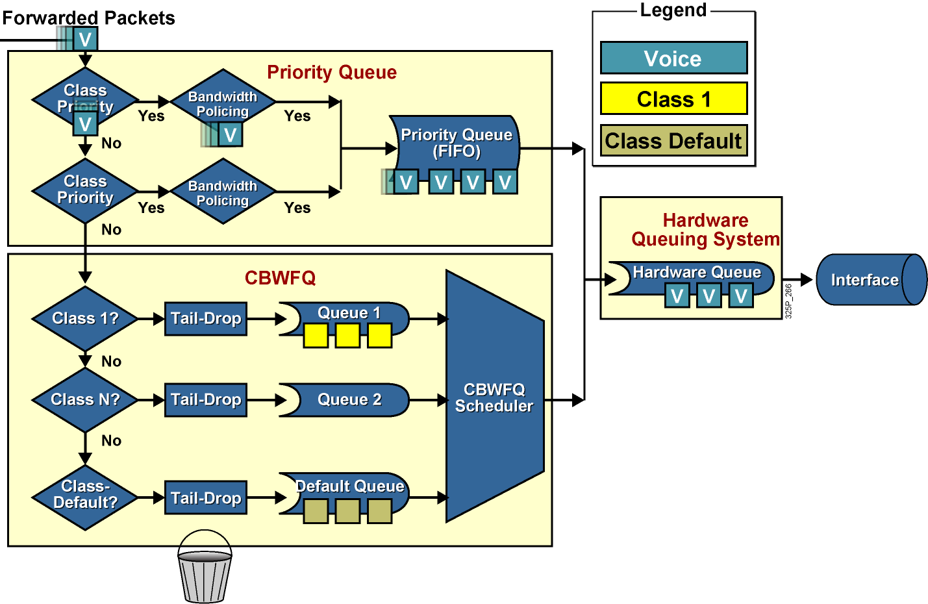
Architektúra LLQ
Notes:
LLQ extends CBWFQ by adding strict-priority queuing.
Strict-priority queuing allows delay-sensitive data such as voice to be dequeued and sent first. Voice packets that enter the LLQ system are sent to the priority queue part of the LLQ system, where they have a fixed bandwidth allocation and where they are served first. Data packets enter the CBWFQ system directly where CBWFQ assigned weights determine how they are treated.
Without LLQ, CBWFQ provides weighted queuing based on defined per-class bandwidth with no strict-priority queue available for real-time traffic. CBWFQ allows you to define traffic classes and then assign characteristics to that class. For example, you can designate the minimum bandwidth delivered to the class during congestion.

Slide 16
Konfigurácia LLQ
router(config-pmap-c)#
priority bandwidth [burst]
Alokuje triede fixné pásmo (kbps) a garantuje čo najrýchlejšie odoslanie paketov
Prevádzka presahujúca toto pásmo bude v prípade zahltenia rozhrania zahodená
router(config-pmap-c)#
priority percent percentage [burst]
Alokuje triede percentáž z rezervovateľného pásma
Prevádzka presahujúca alokovanú percentáž bude v prípade zahltenia rozhrania zahodená
Notes:
When you specify the priority command for a class, you can use the bandwidth argument to specify the maximum bandwidth in kilobits per second.
You use this parameter to specify the maximum amount of bandwidth allocated for packets belonging to the class configured with the priority command. The bandwidth parameter both guarantees bandwidth to the priority class and restrains the flow of packets from the priority class.
Keep the following guidelines in mind when using the priority command:
Layer 2 encapsulations are accounted for in the amount of bandwidth specified with the priority command. Therefore, ensure that a bandwidth allocation is configured with room for the Layer 2 overhead.
Use the priority command for VoIP on serial links and ATM PVCs.

Slide 17
Príklad konfigurácie LLQ
class-map voip
match ip precedence 5
!
class-map mission-critical
match ip precedence 3 4
!
class-map transactional
match ip precedence 1 2
!
policy-map Policy1
class voip
priority percent 10
class mission-critical
bandwidth percent 30
class transactional
bandwidth percent 20
class class-default
fair-queue
Notes:
This is a configuration example where the VoIP traffic class, classified based on the IP precedence of 5, is queued in the LLQ priority queue. The priority class is guaranteed but is also limited to 10 percent of interface bandwidth.

Slide 18
Kontrola LLQ
router>
show policy-map interface interface
Zobrazí informácie o použitej policy-map, jednotlivých triedach a ich obsluhe, obslúžených a zahodených paketoch a ďalšie info
router>show policy-map interface fastethernet 0/0
FastEthernet0/0
Service-policy output: LLQ
Class-map: LLQ (match-any)
0 packets, 0 bytes
5 minute offered rate 0 bps, drop rate 0 bps
Match: any
Weighted Fair Queueing
Strict Priority
Output Queue: Conversation 264
Bandwidth 1000 (kbps) Burst 25000 (Bytes)
(pkts matched/bytes matched) 0/0
(total drops/bytes drops) 0/0
Class-map: class-default (match-any)
0 packets, 0 bytes
5 minute offered rate 0 bps, drop rate 0 bps
Match: any
Notes:
The show policy-map interface command displays the packet statistics of all classes that you configured for all service policies on the specified interface.
Class-map: Class of traffic being displayed. Output is displayed for each configured class in the policy.
offered rate: Rate, in kilobits per second, of packets entering the class.
drop rate: Rate, in kilobits per second, at which packets are dropped from the class. The drop rate is calculated by subtracting the number of successfully transmitted packets from the offered rate.
Match: Match criteria specified for the class of traffic.
pkts matched/bytes matched: Number of packets (shown in bytes) matching this class that were placed in the queue.
depth/total drops/no-buffer drops: Number of packets, in bytes, discarded for this class. “No-buffer” indicates that no memory buffer exists to service the packet.

Slide 19
Module 4: Implement the DiffServ QoS Model
Lesson 4.6: Predchádzanie zahlteniu (Congestion Avoidance)

Slide 20
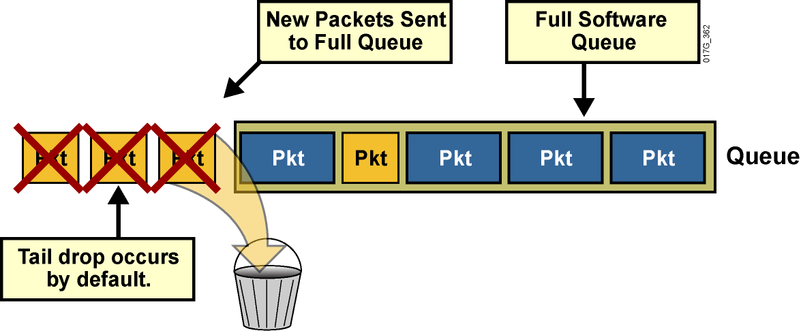
Tail Drop pri zahltení rozhrania
Pri ukladaní paketov do frontov na rozhraniach sa najprv pakety ukladajú do hardvérových TxQ
Ak rozhranie signalizuje plný TxQ, pakety sa odkladajú do softvérových frontov (t.j. WFQ/CBWFQ/LLQ fronty)
Ak sú zaplnené aj softvérové fronty, dochádza k javu Tail Drop
Notes:
When an interface on a router cannot transmit a packet immediately, the packet is queued, either in an interface transmit (Tx) ring or the interface output hold queue, depending on the switching path that is used. Packets are then taken out of the queue and eventually transmitted on the interface.
If the arrival rate of packets to the output interface exceeds the ability of the router to buffer and forward traffic, the queues increase to their maximum length and the interface becomes congested. Tail drop is the default queuing response to congestion. Tail drop treats all traffic equally and does not differentiate among classes of service.
This graphic shows tail drop occurring by default. Applications may suffer performance degradation stemming from packet loss caused by tail drop. When the output queue is full and tail drop is in effect, all packets trying to enter (at the tail of) the queue are dropped until the queue is no longer full.
Weighted fair queuing (WFQ), if configured on an interface, provides a more sophisticated scheme for dropping traffic. WFQ punishes the most aggressive flows using a congestive discard threshold (CDT)-based dropping algorithm.

Slide 21
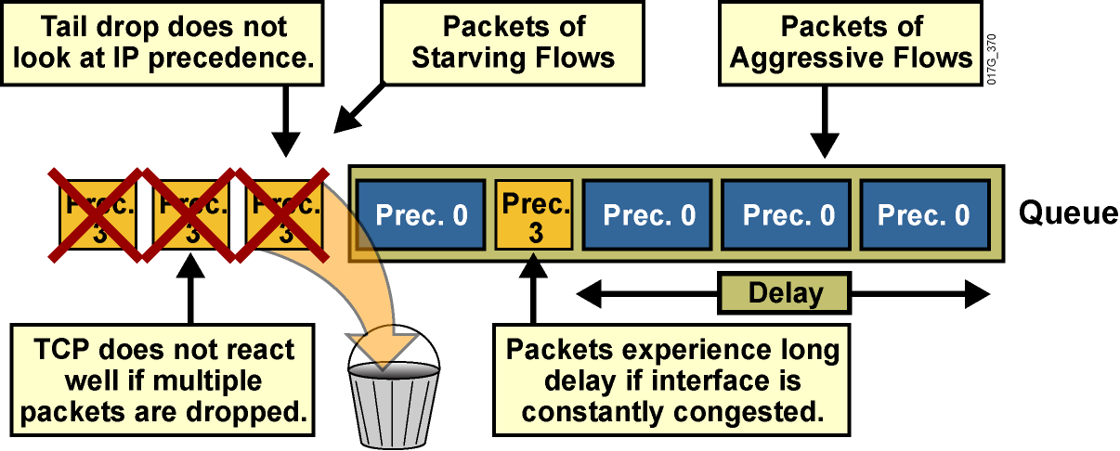
Obmedzenia princípu Tail Drop
Trvalo zaplnené fronty vedú k zvýšenému oneskoreniu
Premenlivé zapĺňanie frontov vedie k jitteru
Veľmi agresívne toky dát môžu spôsobiť starváciu iných, subtílnejších
Zahadzovanie nerozlišuje dôležitosť paketov
Notes:
Another TCP-related phenomenon that reduces optimal throughput of network applications is TCP starvation.
When multiple flows are being transmitted through a router, some of these flows may be much more aggressive than other flows. For instance, when the TCP transmit window increases for file-transfer applications, the TCP session can send a number of large packets to its destination. These packets immediately fill the queue on the router, and other, less aggressive flows can be starved because there is no differentiated treatment indicating which packets should be dropped. As a result, less aggressive flows are dropped at the output interface.
Again, tail drop does not address this issue.

Slide 22
Obmedzenia princípu Tail Drop
Tail Drop je prirodzené riešenie situácie s preplnenou pamäťou – ak je plná, ďalšie pakety zahodiť
Za istých okolností však tento princíp nemá dobré vlastnosti najmä pri protokoloch so spätnou väzbou
Efekt TCP synchronizácie
Efekt TCP starvácie
Niet rozdielu medzi dôležitosťou zahadzovaných paketov – zahodí sa ten paket, ktorý sa nezmestil, nie ten, ktorý je menej dôležitý
Notes:
The simple tail-drop scheme does not work very well in environments with a large number of TCP flows or in environments in which selective dropping is required. Understanding the network interaction between TCP stack intelligence and dropping is required to implement a more efficient and fair dropping scheme, especially in service provider environments.
Tail drop has the following shortcomings:
Normally, when congestion occurs, dropping affects most of the TCP sessions, which simultaneously back off and then restart again. This process causes inefficient link utilization at the congestion point (TCP global synchronization). To avoid dropping of TCP packets, TCP reduces the window size.
TCP starvation occurs, in which all buffers are temporarily seized by aggressive flows, and normal TCP flows experience buffer starvation.
There is no differentiated drop mechanism, and therefore higher-priority traffic is dropped in the same way as best-effort traffic.

Slide 23
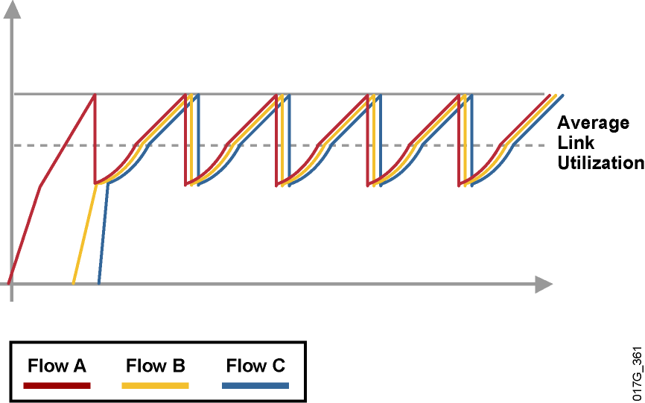
TCP synchronizácia
Predpokladajme, že cez to isté rozhranie tečú tri nezávislé TCP toky, mohli začať v rôznych časoch (nie je podstatné)
TCP postupne zvyšovalo prenosovú rýchlosť otváraním okna
Ak každý tok bol intenzívny, zahltenie rozhrania môže spôsobiť, že každému z tokov sa aspoň jeden paket musí kvôli Tail Drop zahodiť
Všetky toky teda súčasne spomalia a potom súčasne zrýchlia
Notes:
Global synchronization is a TCP-related phenomenon that reduces optimal throughput of network applications. Tail drop contributes to this phenomenon.
A router can handle multiple concurrent TCP sessions. However, bursty network traffic could cause a router to fail if the traffic exceeds the queue limit.
This graphic illustrates the issue of TCP synchronization. If the receiving router drops all traffic that exceeds the queue limit (the default tail drop action), many TCP sessions then simultaneously go into slow start. Traffic temporarily slows down to the extreme, and then all flows go into slow start again. This activity creates a condition called global synchronization.
Global synchronization occurs as waves of congestion crest, only to be followed by troughs during which the transmission link is not fully used. Global synchronization of TCP hosts can occur because packets are dropped all at once. Global synchronization occurs when multiple TCP hosts reduce their transmission rates in response to packet dropping. When congestion is reduced, their transmission rates are increased.
The waves of transmission known as global synchronization result in significant link underutilization.

Slide 24
Random Early Detection (RED)
Efektom spôsobeným vďaka Tail Drop je možné predísť technikou nazývanou Random Early Detection (RED)
Základnou ideou je zaviesť do zahadzovania paketov istú náhodnosť – zahodiť pakety len s istou pravdepodobnosťou
Táto pravdepodobnosť je nulová, ak je front prázdny
Pravdepodobnosť zahodenia bude rásť úmerne so zaplnením frontu, teda čím plnší front, tým pravdepodobnejšie dôjde k zahodeniu
Po prekročení istej prahovej hodnoty sa zahadzuje štýlom Tail Drop (nie nevyhnutne pri úplne plnom fronte!)
Dôsledky
Náhodné zahadzovanie nepostihne všetky TCP toky naraz, čím sa predchádza synchronizácii
TCP sa adaptívne prispôsobí dosiahnuteľnej kapacite
Je možné predpokladať, že priemerná dĺžka frontu bude kratšia vďaka „oportunistickému“ zahadzovaniu, čo má pozitívny vplyv na oneskorenie
Notes:
Random early detection (RED) is a dropping mechanism that randomly drops packets before a queue is full, thus helping to avoid tail drop.
The basis of the dropping strategy is the average queue length—that is, when the average size of the queue increases, RED is more likely to drop an incoming packet than when the average queue length is shorter.
Because RED drops packets randomly, it has no per-flow intelligence. The rationale is that an aggressive flow will represent most of the arriving traffic, and it is likely that RED will drop a packet of an aggressive session. RED therefore punishes more aggressive sessions with a higher statistical probability and is able to somewhat selectively slow the most significant cause of congestion. Directing one TCP session at a time to slow down allows for full utilization of the bandwidth rather than utilization that manifests itself as crests and troughs of traffic.
As a result of implementing RED, TCP global synchronization is much less likely to occur, and TCP can use link bandwidth more efficiently.
In RED implementations, the average queue size also decreases significantly because the possibility of the queue filling up is reduced. This is because RED is very aggressive in tail dropping when traffic bursts occur and the queue is already quite full.
RED distributes losses over time and normally maintains a low queue depth while absorbing traffic spikes. RED can also utilize IP precedence or differentiated services code point (DSCP) bits in packets to establish different drop profiles for different classes of traffic.
RED is useful only when the bulk of the traffic is TCP traffic. With TCP, dropped packets indicate congestion, so the packet source reduces its transmission rate. With other protocols, packet sources might not respond or might re-send dropped packets at the same rate, and so dropping packets might not decrease congestion.

Slide 25
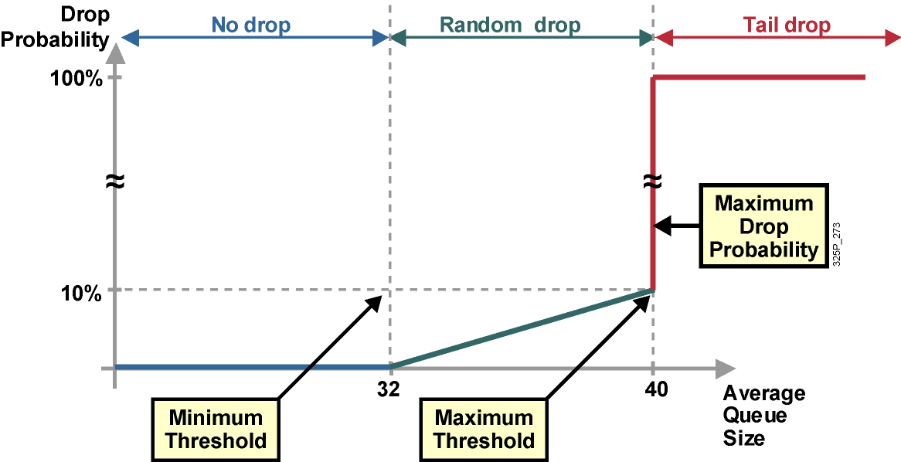
RED profil
Notes:
RED uses a traffic profile to determine the packet-dropping strategy based on the average queue length. The packet drop probability is based on the minimum threshold, maximum threshold, and mark probability denominator. When the average queue depth is above the minimum threshold, RED starts dropping packets. The rate of packet drop increases linearly as the average queue size increases until the average queue size reaches the maximum threshold.
The figure shows that depending on queue length, the profile assigns a no drop, a random drop or full drop probability.
The probability of a packet being dropped is based on three configurable parameters contained within the RED profile:
Minimum threshold: When the average queue length is above the minimum threshold, RED starts dropping packets. The rate of packet drop increases linearly as the average queue size increases, until the average queue size reaches the maximum threshold.
Maximum threshold: When the average queue size is above the maximum threshold, all packets are dropped.
Mark probability denominator: This number is the fraction of packets that are dropped when the average queue depth is at the maximum threshold. For example, if the denominator is 512, one out of every 512 packets is dropped when the average queue is at the maximum threshold. The linear increase of packet drops from the minimum threshold (0 drops) to the maximum threshold is based on this parameter and the queue size between the minimum and maximum thresholds.
The minimum threshold value should be set high enough to maximize link utilization. If the minimum threshold is too low, packets may be dropped unnecessarily, and the transmission link will not be fully used.
The difference between the maximum threshold and the minimum threshold should be large enough to avoid global synchronization. If the difference is too small, many packets may be dropped at once, resulting in global synchronization.

Slide 26
Režimy práce RED
S ohľadom na zahadzovanie paketov sa RED môže nachádzať v troch režimoch:
Bez zahadzovania: Vždy, keď priemerná dĺžka frontu je menšia ako minimálna prahová hodnota
Náhodné zahadzovanie (Random Drop): Vždy, keď priemerná dĺžka frontu je medzi min a max prahovou hodnotou
Tvrdé zahadzovanie (Tail Drop): Vždy, keď priemerná dĺžka frontu je väčšia ako maximálna prahová hodnota
Náhodné zahadzovanie má šancu prechádzať úplnému zaplneniu frontu, ak protokol reaguje na zahadzovanie
TCP, SCTP, DCCP majú spätnú väzbu o zahodeniach
UDP, UDP-Lite samy osebe ignorujú straty paketov
Notes:
Three RED dropping modes can be used in TCP that are based on the average queue size:
When the average queue size is between 0 and the configured minimum threshold, no drops occur and all packets are queued.
When the average queue size is between the configured minimum threshold and the configured maximum threshold, random drops occur, which is linearly proportional to the mark probability denominator and the average queue length.
When the average queue size is at or higher than the maximum threshold, RED performs full (tail) drop in the queue. This situation is unlikely, because RED should slow down TCP traffic ahead of congestion. If a lot of non-TCP traffic is present, RED cannot effectively drop traffic to reduce congestion, and tail drops are likely to occur.

Slide 27
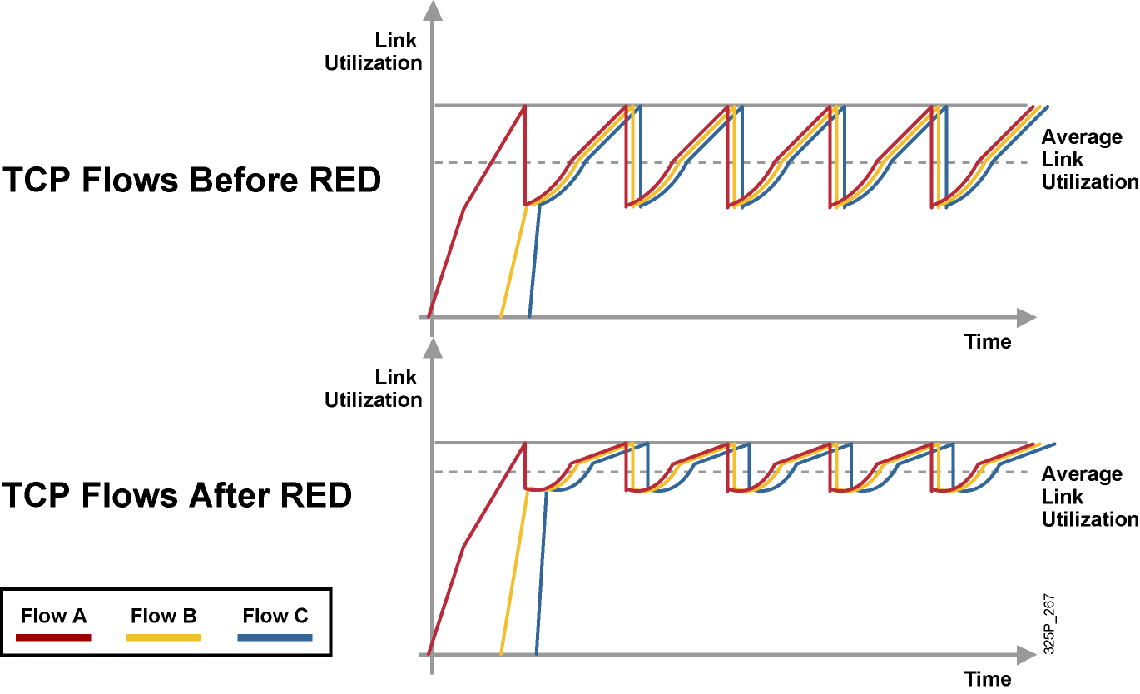
Správanie TCP pri použití RED
Notes:
These graphics show TCP throughput behavior compared to link bandwidth in a congested network scenario where the tail-drop and RED mechanisms are in use on the link.
Before RED, when all sessions slow down, congestion on the router interface is removed and all TCP sessions restart their transmission at about the same time. Again, the router interface quickly becomes congested, causing tail drop. As a result, all TCP sessions back off again. This behavior cycles constantly, resulting in a link that is generally underutilized.
After RED is applied, RED randomly drops packets, influencing a small number of sessions at a time, before the interface reaches congestion. Overall throughput of sessions is increased, as is average link utilization. Global synchronization is very unlikely to occur because of selective, but random, dropping of adaptive traffic.

Slide 28
Weighted Random Early Detection (WRED)
WRED je modifikácia mechanizmu RED, ktorá využíva rôzne RED profily pre rôzne kategórie dôležitosti paketov resp. pravdepodobnosti ich zahodenia
Triedy Assured Forwarding (AFxy) v parametri y vyjadrujú pravdepodobnosť zahodenia (1: malá, 2: stredná, 3: veľká)
Každý profil je definovaný trojicou parametrov
Minimálna prahová hodnota (Minimum threshold)
Maximálna prahová hodnota (Maximum threshold)
Mark probability denominator
WRED profile selection is based on:
IP precedence (8 profiles)
DSCP (64 profiles)
WRED drops less important packets more aggressively than more important packets.
Notes:
Cisco does not support RED. Instead, Cisco supports weighted random early detection (WRED) which combines RED with IP precedence or DSCP and performs packet dropping based on IP precedence or DSCP markings.
For example, a packet with an IP precedence value of 0 might have a minimum threshold of 20 packets, whereas a packet with an IP precedence of 1 might have a minimum threshold of 25 packets. In this example, packets with an IP precedence of 0 would start to be discarded before packets with an IP precedence of 1.
As with RED, WRED monitors the average queue length in the router and determines when to begin discarding packets based on the length of the interface queue. When the average queue length exceeds the user-specified minimum threshold, WRED begins to randomly drop packets with a certain probability. If the average length of the queue continues to increase so that it becomes larger than the user-specified maximum threshold, WRED reverts to a tail-drop packet-discard strategy, in which all incoming packets are dropped.
The idea behind using WRED is to maintain the queue length at a level somewhere below the maximum threshold and to implement different drop policies for different classes of traffic. WRED can selectively discard lower-priority traffic when the interface becomes congested and can provide differentiated performance characteristics for different classes of service. WRED can also be configured to produce nonweighted RED behavior.
For interfaces configured to use Resource Reservation Protocol (RSVP), WRED chooses packets from other flows to drop rather than the RSVP flows. Also, IP precedence or DSCP helps determine which packets are dropped, because traffic at a lower priority has a higher drop rate than traffic at a higher priority (and, therefore, lower-priority traffic is more likely to be throttled back). In addition, WRED statistically drops more packets from large users than from small users. The traffic sources that generate the most traffic are more likely to be slowed than traffic sources that generate little traffic.
WRED reduces the chances of tail drop by selectively dropping packets when the output interface begins to show signs of congestion. By dropping some packets early rather than waiting until the queue is full, WRED avoids dropping large numbers of packets at once and minimizes the chances of global synchronization. As a result, WRED helps maximize the utilization of transmission lines.
WRED treats non-IP traffic as precedence 0, the lowest precedence. Therefore, non-IP traffic, in general, is more likely to be dropped than IP traffic.
WRED should be used wherever there is a potential congested link (bottleneck), which could very well be an access or edge link; however, WRED is normally used in the core routers of a network rather than at the network edge. Edge routers assign IP precedence or DSCP to packets as they enter the network. WRED uses these assigned values to determine how to treat different types of traffic.
Note that Cisco does not recommend WRED for any voice queue, although you may enable WRED on an interface carrying voice traffic. WRED will not throttle back voice traffic because voice traffic is User Datagram Protocol (UDP)-based.

Slide 29
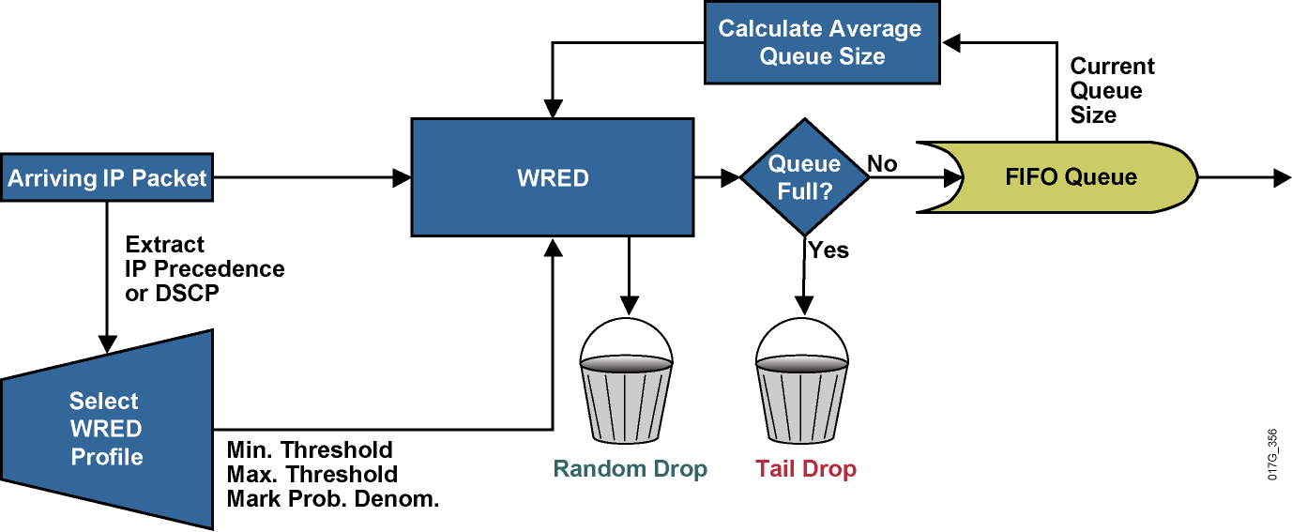
WRED Building Blocks
Notes:
There are several parameters used by WRED to influence packet-drop decisions.
The router constantly updates the WRED algorithm with the calculated average queue length, which is based on the recent history of queue lengths.
Configured in the traffic profile are the parameters that define the drop characteristics used by WRED (minimum threshold, maximum threshold, and mark probability denominator). These parameters define the WRED probability slopes.
When a packet arrives at the output queue, the IP precedence or DSCP value is used to select the correct WRED profile for the packet. The packet is then passed to WRED for processing. Based on the selected traffic profile and the average queue length, WRED calculates the probability for dropping the current packet and either drops the packet or passes it to the output queue.
If the queue is already full, the packet is dropped. Otherwise, the packet is eventually transmitted out to the interface. If the average queue length is greater than the minimum threshold but less than the maximum threshold, based on the drop probability, WRED either queues the packet or performs a random drop.

Slide 30
Class-Based WRED (CBWRED)
Class-based WRED is available when configured in combination with CBWFQ.
Using CBWFQ with WRED allows the implementation of DiffServ Assured Forwarding PHB.
Class-based configuration of WRED is identical to stand-alone WRED.
Notes:
Traditionally, Cisco IOS software used stand-alone RED and WRED mechanisms to avoid congestion on an interface. Those mechanisms can perform a differentiated drop based on the IP precedence or DSCP value.
The class-based weighted fair queuing (CBWFQ) system supports the use of WRED inside the queuing system, thereby implementing class-based WRED (CBWRED).
Each class is queued in its separate queue and has a queue limit, performing tail drop by default. WRED can be configured as the preferred dropping method in a queue, implementing a differentiated drop based on traffic class or on the IP precedence or DSCP value.

Slide 31
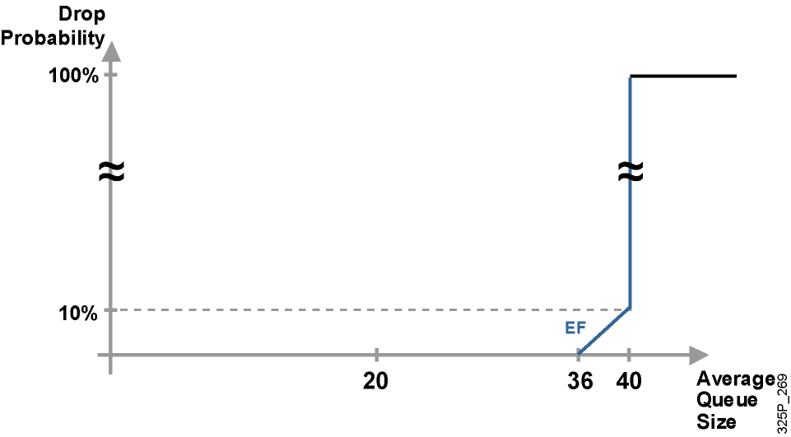
DSCP-Based WRED (Expedited Forwarding)
Notes:
Recall that a per hop behavior (PHB) is the externally observable forwarding behavior applied at a DiffServ-compliant node to a DiffServ behavior aggregate (BA).
Expedited Forwarding (EF) PHB is suggested for applications that require a hard guarantee on the delay and jitter. Typically, mission critical applications would require this service and would be allocated a small percentage of the total network capacity.
In DSCP, the Expedited Forwarding (EF) PHB is identified based on these parameters:
A low departure rate is ensured to provide low delay to delay-sensitive applications.
Bandwidth is guaranteed to prevent starvation of the application if there are multiple applications using EF PHB.
Bandwidth is policed to prevent starvation of other applications or classes that are not using this PHB.
Packets requiring EF should be marked with DSCP binary value 101110 (46).
For the EF DiffServ traffic class, WRED configures itself by default so that the minimum threshold is very high, increasing the probability of no drops being applied to that traffic class. It is expected that EF traffic will be dropped very late, compared to other traffic classes, and the EF traffic is therefore prioritized in the event of congestion.

Slide 32
Configuring CBWRED
router(config-pmap-c)#
random-detect
Enables IP precedence-based WRED in the selected class within the service policy configuration mode.
Default service profile is used.
Command can be used at the interface, perVC (with random-detect-group), or at the class level (service policy).
Precedence-based WRED is the default mode.
WRED treats non-IP traffic as precedence 0.
policy-map Policy1
class mission-critical
bandwidth percent 30
random-detect
class transactional
bandwidth percent 20
random-detect
class class-default
fair-queue
random-detect
Notes:
The random-detect command is used to enable WRED on an interface. By default, WRED is IP precedence-based and uses eight default WRED profiles, one for each value of IP precedence.
Within the CBWFQ system, WRED is used to perform per-queue dropping within the class queues. Therefore, each class queue has its own WRED method, which can be further weighed based on the IP precedence or DSCP value. Each queue can therefore be configured with a separate drop policy to implement different drop policies for every class of traffic.
WRED treats all non-IP traffic as precedence 0. As a result, non-IP traffic is more likely to be dropped than IP traffic.
WRED cannot be configured on the same interface as custom queuing (CQ), priority queuing (PQ), or WFQ. However, CBWRED can be configured in conjunction with CBWFQ. Restricting nondistributed, non-class-based WRED to only FIFO queuing on an interface is typically not a major issue because WRED is usually applied in the network core, where advanced queuing mechanisms are not typically used. WRED is suited for the network core because WRED has a relatively low performance impact on routers.

Slide 33
Changing the WRED Traffic Profile
router(config-pmap-c)#
random-detect precedence precedence min-threshold max-threshold mark-prob-denominator
Changes WRED profile for specified IP precedence value.
Packet drop probability at maximum threshold is:
1 / mark-prob-denominator
Nonweighted RED is achieved by using the same WRED profile for all precedence values.
Notes:
When WRED is enabled, default values are selected for each traffic profile based on the weight used (IP precedence or DSCP). Network administrators can then modify these default values to match their specific administrative quality of service (QoS) policy goals. This figure shows the command syntax for changing WRED traffic profiles.
When you are modifying the default WRED profile for IP precedence, the following values are configurable:
Minimum threshold: When the average queue depth is above the minimum threshold, WRED starts dropping packets. The rate of packet drop increases linearly as the average queue size increases, until the average queue size reaches the maximum threshold. The size of the hold queue is equivalent to the number of packets that can be held within a queue. The hold-queue length ranges from 0 to 4096, and, therefore, the minimum/maximum threshold range is 1 to 4096.
Maximum threshold: When the average queue size is above the maximum threshold, all packets are dropped. If the difference between the maximum threshold and the minimum threshold is too small, many packets might be dropped at once, resulting in global synchronization. The default maximum threshold will reflect the defined hold-queue size. Thus, if the hold queue is changed, the maximum threshold will change.
Mark probability denominator: This is the fraction of packets dropped when the average queue depth is at the maximum threshold. For example, if the denominator is 10, one out of every 10 packets is dropped when the average queue is at the maximum threshold. The maximum probability of drop at the maximum threshold can be expressed as 1 / mark-prob-denominator. The maximum drop probability is 10 percent if default settings are used that have a mark probability denominator value of 10. The value of the mark probability can range from 1 to 65,536.
If required, RED can be configured as a special case of WRED, by assigning the same profile to all eight IP precedence values. The default WRED parameter parameters are based on the best available data. It is recommended that these parameters not be changed from their default values unless you have determined that your applications will benefit from the changed values.

Slide 34
CBWFQ Using IP Precedence with CBWRED
Enable CBWFQ to prioritize traffic according to the following requirements:
Class mission-critical is marked with IP precedence values 3 and 4 (3 is high drop, 4 is low drop) and should get 30% of interface bandwidth.
Class bulk is marked with IP precedence values 1 and 2 (1 is high drop, 2 is low drop) and should get 20% of interface bandwidth.
All other traffic should be per-flow fair-queued.
Use differentiated WRED to prevent congestion in all three classes.
Notes:
The example service policy here shows an IP precedence CBWRED deployment.
This example of CBWFQ with WRED focuses on a network that provides the following three different service levels for three traffic classes:
Mission-critical class: This class is marked with IP precedence values 3 and 4 (3 is used for high-drop service, and 4 is used for low-drop service within the service class) and should get 30 percent of an interface bandwidth.
Bulk class: This class is marked with IP precedence values 1 and 2 (1 is used for high-drop service, and 2 is used for low-drop service) and should get 20 percent of the interface bandwidth.
Best-effort class: This class should get the remaining bandwidth share and should be fair-queued.
To enforce this service policy, a router uses CBWFQ to perform bandwidth sharing and WRED within service classes to perform differentiated dropping.

Slide 35
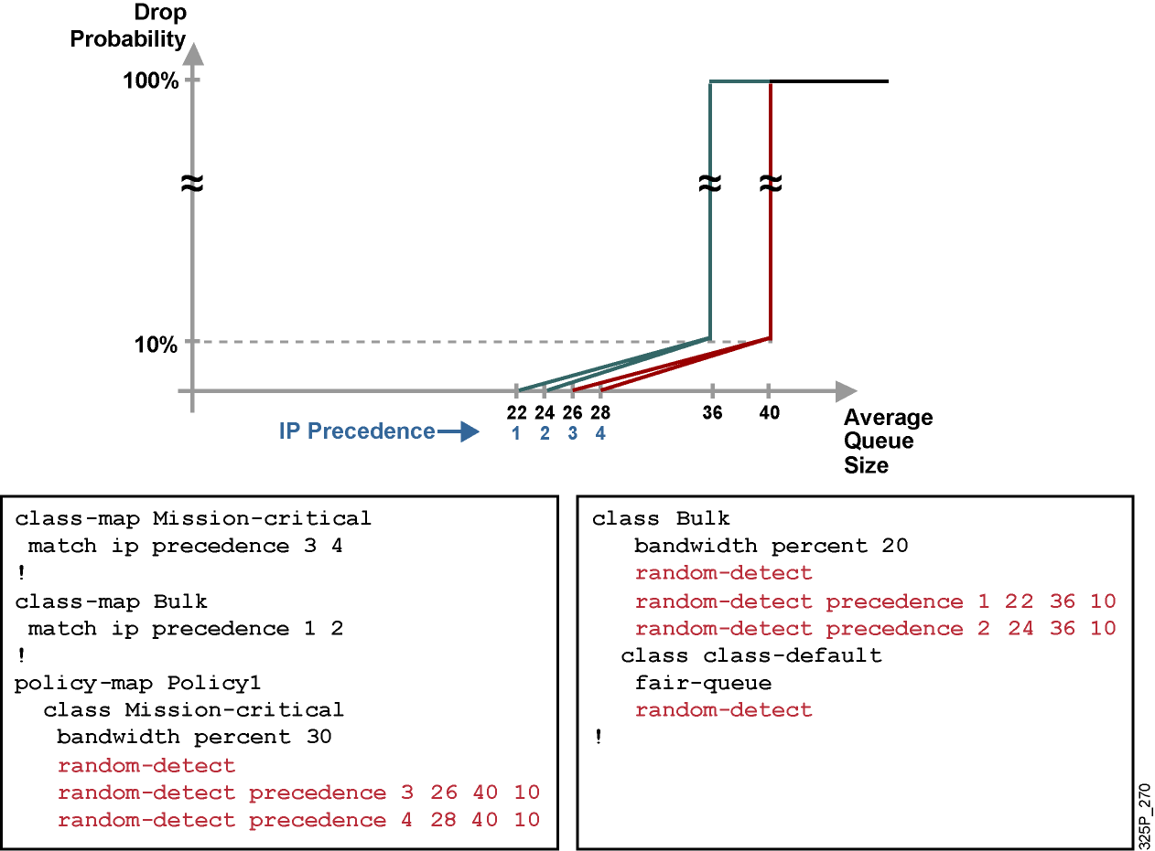
Sample WRED Traffic Profile with CBWRED
Notes:
This graphic shows the WRED traffic profile representing the QoS policy and the configuration that is used to implement the example service policy. The traffic is classified based on the IP precedence bits, and all noncontract traffic is classified into the default class:
The mission-critical class is guaranteed at least 30 percent of bandwidth with a custom WRED profile that establishes a low-drop and a high-drop PHB.
The bulk class is guaranteed at least 20 percent of bandwidth, is configured with somewhat lower WRED drop thresholds, and is therefore more likely to be dropped than the mission-critical class if interface congestion occurs.
All other traffic is part of the default class and is fair-queued with default WRED parameters.

Slide 36
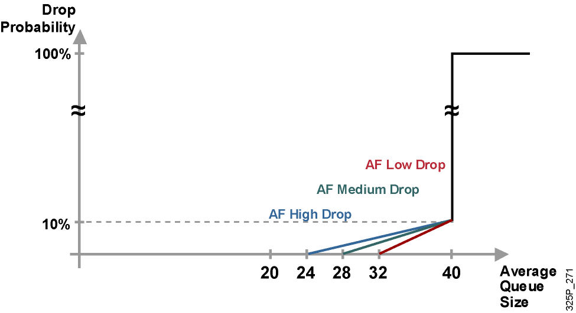
WRED Profiles: DSCP-Based WRED (Assured Forwarding)
Notes:
In DSCP, the following parameters identify Assured Forwarding (AF) PHB based on:
Guarantees a certain amount of bandwidth to an AF class.
Allows access to extra bandwidth, if available.
Packets requiring AF PHB should be marked with DSCP value aaadd0, where aaa is the number of the class and dd is the drop probability, or drop preference, of the traffic class.
There are four defined AF classes. Each class should be treated independently and have bandwidth allocated that is based on the QoS policy.
For the AF DiffServ traffic class, WRED configures itself by default for three different profiles, depending on the drop preference DSCP marking bits. Therefore, AF traffic should be classified into the three possible classes, such as AF high drop, AF medium drop, and AF low drop. These three classes are based on the sensitivity to packet drops of the application or applications represented by the class. This would mean that the mission-critical class would have an AF low drop, an AF medium drop, and an AF high drop.

Slide 37
Configuring DSCP-Based CBWRED
router(config-pmap-c)#
random-detect dscp-based
Enables DSCP-based WRED.
Command can be used at the interface, perVC (with random detect group), or at the class level (service policy).
Default service profile is used.
The WRED random-detect command and the WFQ queue-limit command are mutually exclusive for class policy.
Notes:
The random-detect dscp-based command is used to enable DSCP-based WRED on an interface. Changing WRED weighting to values based on DSCP increases the number of WRED traffic profiles to 64 (as compared to 8 profiles for precedence-based WRED). This graphic shows the command syntax.
You can configure WRED as part of the policy for a standard class or the default class. The WRED random-detect command and the WFQ queue-limit command are mutually exclusive for class policy. If you configure WRED, its packet-drop capability is used to manage the queue when packets exceeding the configured maximum count are enqueued. If you configure the WFQ queue-limit command for class policy, tail drop is used.
WRED cannot be configured on the same interface as custom queuing (CQ), priority queuing (PQ), or weighted fair queuing (WFQ). However, CB-WRED can be configured in conjunction with CBWFQ. Restricting nondistributed, non-class-based WRED only to FIFO queuing on an interface is not a major issue because WRED is usually applied in the network core, where advanced queuing mechanisms are not typically deployed. WRED is suited for the network core because it has a relatively low performance impact on routers.

Slide 38
Changing the WRED Traffic Profile
router(config-pmap-c)#
random-detect dscp dscpvalue min-threshold max-threshold mark-prob-denominator
Changes WRED profile for specified DSCP value
Packet drop probability at maximum threshold is: 1 / mark-prob-denominator
Notes:
When DSCP-based WRED is enabled, default values are selected for each traffic profile based on DSCP. Network administrators can then modify these default values to match their specific administrative QoS policy goals. This figure shows the command syntax.
When you are modifying the default WRED profile for DSCP, the same values described previously for IP precedence are configurable, except that the minimum threshold, the maximum threshold, and the mark probability denominator will be applied to DSCP classified packets.

Slide 39
CBWRED Using DSCP: Example
Enable CBWFQ to prioritize traffic according to the following requirements:
Class mission-critical is marked using DSCP AF2 and should get 30% of interface bandwidth.
Class bulk is marked using DSCP AF1 and should get 20% of interface bandwidth.
All other traffic should be per-flow fair-queued.
Use differentiated WRED to prevent congestion in all three classes.
Make sure that the new configurations still conform to the design and implementation from the previous example.
Notes:
This example shows DSCP-based CBWRED.
Remember that the DiffServ model itself provides defined traffic classes and their associated PHBs. DiffServ-based classification is used in this example as follows:
Mission-critical class: This class is marked using DSCP AF class 2 and should get 30 percent of an interface bandwidth.
Bulk class: This class is marked using DSCP AF class 1 and should get 20 percent of the interface bandwidth.
Best-effort class: This traffic should get the remaining bandwidth share and should be fair-queued.

Slide 40
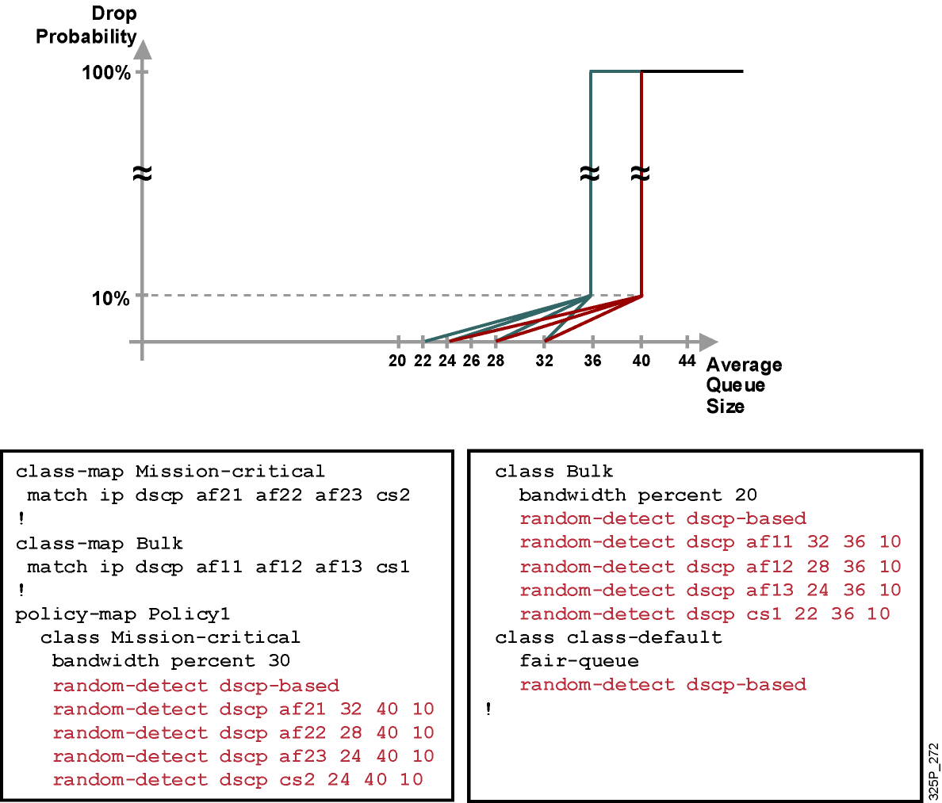
CBWRED Using DSCP: Example (Cont.)
Notes:
To enforce this service policy, a router uses CBWFQ to perform bandwidth sharing and uses WRED within service classes to perform differentiated drop. This example shows sample drop profile graphs and outputs.
The configuration example shows how traffic classification is performed using DSCP-based classes, representing the mission-critical class as the AF1 class, and the bulk class as the AF2 class. WRED DSCP-based parameters are set reflecting the class-dependent drop strategy:
The mission-critical class is guaranteed at least 30 percent of bandwidth, with a custom WRED profile that establishes three different drop probabilities for AF class 2. The minimum threshold for DSCP AF21 packets is 32. The minimum threshold for DSCP AF22 packets is 28. The minimum threshold for DSCP AF23 and CS2 packets is 24. The maximum threshold for all Mission-critical traffic is 40 - the default maximum threshold is equal to the default hold queue size (40) on an interface. The (default) mark probability is 10 for the Mission-critical traffic (one out of every 10 packets is dropped when the average queue depth is at the maximum threshold – the average queue size changes with time as a function of the previously calculated average queue size and the current queue size).
The bulk class is guaranteed at least 20 percent of bandwidth, is configured with three different drop probabilities for AF class 1, and has a somewhat lower WRED maximum threshold. As a result, bulk-class traffic is more likely to be dropped than the mission-critical class if interface congestion occurs. The minimum threshold for DSCP AF11 packets is 32. The minimum threshold for DSCP AF12 packets is 28. The minimum threshold for DSCP AF13 packets is 24. The minimum threshold for DSCP CS1 packets is 24. The maximum threshold for all Mission-critical traffic is 36. The (default) mark probability is 10 for the Bulk traffic.
All other traffic is part of the default class and is fair-queued, with default WRED parameters.

Slide 41
Monitoring CBWRED
router#
show policy-map interface interface-name
Displays the configuration of all classes configured for all service policies on the specified interface
router#show policy-map interface Ethernet 0/0
Ethernet0/0
Service-policy output: Policy1
Class-map: Mission-critical (match-all)
0 packets, 0 bytes 5 minute offered rate 0 bps, drop rate 0 bps
Match: ip precedence 2 Match: ip dscp 18 20 22
Weighted Fair Queueing
Output Queue: Conversation 265
Bandwidth 30 (%) Bandwidth 3000 (kbps)
(pkts matched/bytes matched) 0/0
(depth/total drops/no-buffer drops) 0/0/0
exponential weight: 9
mean queue depth: 0
Dscp Transmitted Random drop Tail drop Minimum Maximum Mark
(Prec) pkts/bytes pkts/bytes pkts/bytes threshold threshold probability
0(0) 0/0 0/0 0/0 20 40 1/10
1 0/0 0/0 0/0 22 40 1/10
2 0/0 0/0 0/0 24 40 1/10
Notes:
The show policy-map interface command displays the configuration of all classes configured for all service policies on the specified interface. This includes all WRED parameters implementing the drop policy on the specified interface.
The “Key Fields in the show policy-map interface Command Output” of the output of the show policy-map interface command:
Service-policy output: Name of the output service policy applied to the specified interface or virtual circuit (VC).
Class-map: Class of traffic being displayed. Output is displayed for each configured class in the policy. The choice for implementing class matches (for example, match-all or match-any) can also appear next to the traffic class.
Match: Match criteria specified for the class of traffic. Choices include criteria such as IP precedence, IP DSCP value, Multiprotocol Label Switching (MPLS) experimental (EXP) value, access groups, and QoS groups.
exponential weight: Exponent used in the average queue size calculation for a WRED parameter group.
mean queue depth: Average queue depth based on the actual queue depth on the interface and the exponential weighting constant. It is a fluctuating average. The minimum and maximum thresholds are compared against this value to determine drop decisions.

Slide 42
Module 4: Implement the DiffServ QoS Model
Lesson 4.7: Introducing Traffic Policing and Shaping

Slide 43
Traffic Conditioners
Policing
Limits bandwidth by discarding traffic.
Can re-mark excess traffic and attempt to send.
Should be used on higher-speed interfaces.
Can be applied inbound or outbound.
Shaping
Limits excess traffic by buffering.
Buffering can lead to a delay.
Recommended for slower-speed interfaces.
Cannot re-mark traffic.
Can only be applied in the outbound direction.
Notes:
Traffic conditioners, QoS mechanisms that limit bandwidth, include policing and shaping. Both of these approaches limit bandwidth, but each has different characteristics, as follows:
Policing: Policing typically limits bandwidth by discarding traffic that exceeds a specified rate. However, policing also can re-mark traffic that exceeds the specified rate and attempt to send the traffic anyway. Because of the drop behavior of policing TCP retransmits, policing should be used on higher-speed interfaces. Policing can be applied inbound or outbound on an interface. Traffic policing tools are often configured on interfaces at the edge of a network to limit the rate of traffic entering or leaving the network. In the most common traffic-policing configurations, traffic that conforms is transmitted and traffic that exceeds is sent with a decreased priority or is dropped. Such priorities can be based on IP precedence or DSCP.
Shaping: Shaping limits excess traffic, not by dropping it but by buffering it. This buffering of excess traffic can lead to delay. Because of this delay, shaping is recommended for slower-speed interfaces. Unlike policing, shaping cannot re-mark traffic. As a final contrast, shaping can be applied only in the outbound direction on an interface. Traffic shaping can be used to account for speed mismatches, which are common in nonbroadcast multiaccess (NBMA) networks such as Frame Relay and ATM.

Slide 44
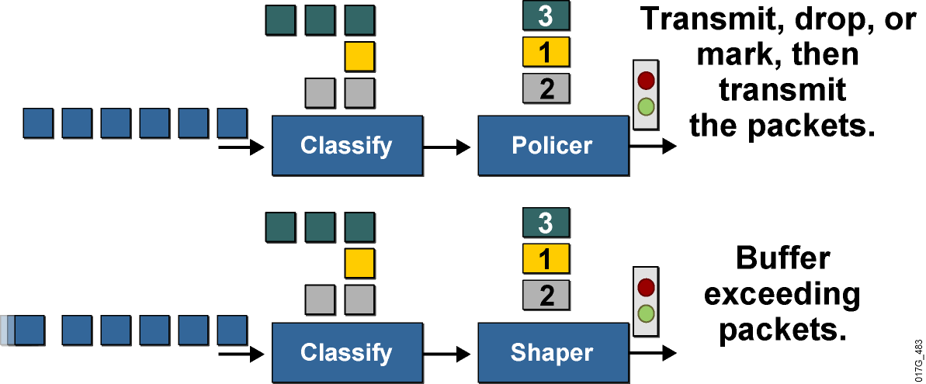
Traffic Policing and Shaping Overview
These mechanisms must classify packets before policing or shaping the traffic rate.
Traffic policing typically drops or marks excess traffic to stay within a traffic rate limit.
Traffic shaping queues excess packets to stay within the desired traffic rate.
Notes:
Both traffic shaping and policing mechanisms are traffic-conditioning mechanisms that are used in a network to control the traffic rate. Both mechanisms use classification so that they can differentiate traffic. They both measure the rate of traffic and compare that rate to the configured traffic-shaping or traffic-policing policy.
The difference between traffic shaping and policing can be described in terms of their implementation. Traffic policing drops excess traffic to control traffic flow within specified rate limits. Traffic policing does not introduce any delay to traffic that conforms to traffic policies. Traffic policing can cause more TCP retransmissions, because traffic in excess of specified limits is dropped.
Traffic-policing mechanisms such as class-based policing or committed access rate (CAR) also have marking capabilities in addition to rate-limiting capabilities. Instead of dropping the excess traffic, traffic policing can mark and then send the excess traffic. This feature allows the excess traffic to be re-marked with a lower priority before the excess traffic is sent out.
Traffic shaping buffers excessive traffic so that the traffic stays within the desired rate. With traffic shaping, traffic bursts are smoothed out by queuing the excess traffic to produce a steadier flow of data. Reducing traffic bursts helps reduce congestion in the network. Traffic shapers such as class-based shaping, Frame Relay traffic shaping (FRTS), or virtual IP (VIP)-based distributed traffic shaping (DTS) in Cisco IOS software do not have the ability to mark traffic.

Slide 45
Why Use Policing? Why Use Shaping?
To limit access to resources when high-speed access is used but not desired (subrate access)
To limit the traffic rate of certain applications or traffic classes
To mark down (recolor) exceeding traffic at Layer 2 or Layer 3
To prevent and manage congestion in ATM, Frame Relay, and Metro Ethernet networks, where asymmetric bandwidths are used along the traffic path
To regulate the sending traffic rate to match the subscribed (committed) rate in ATM, Frame Relay, or Metro Ethernet networks
To implement shaping at the network edge
Notes:
Why Use Policing?
Limiting the access rate on an interface when high-speed physical infrastructure is used in transport. Rate limiting is typically used by service providers to offer customers subrate access. For example, a customer may have an Optical Carrier-3 (OC-3) connection to the service provider but pay only for a T1 access rate. The service provider can rate-limit the customer traffic to T1 speed.
Engineering bandwidth so that traffic rates of certain applications or classes of traffic follow a specified traffic-rate policy. For example, traffic from file-sharing applications may be rate-limited to 64 kbps maximum.
Re-marking excess traffic with a lower priority at Layer 2 and Layer 3 or both before sending the excess traffic out. Cisco class-based traffic policing can be configured to mark packets at both Layer 2 and Layer 3. For example, excess traffic can be re-marked to a lower differentiated services code point (DSCP) value and also have the Frame Relay discard eligible (DE) bit set before the packet is sent out.
Why Use Shaping?
Traffic shaping is typically used to prevent and manage congestion in ATM, Frame Relay, or Metro Ethernet networks, where asymmetric bandwidths are used along the traffic path. If shaping is not used, then buffering can occur at the slow (usually the remote) end, which can lead to queuing and cause delays, and overflow, which can cause packet drops.
Traffic shaping is an attempt to control traffic in ATM, Frame Relay, or Metro Ethernet networks to optimize or guarantee performance, low latency, or bandwidth. Traffic shaping deals with the concepts of classification, queue disciplines, enforcing policies, congestion management, quality of service (QoS), and fairness.
Traffic shaping provides a mechanism to control the volume of traffic being sent into a network (bandwidth throttling) by not allowing the traffic to burst above the subscribed (committed) rate. For this reason, traffic-shaping schemes need to be implemented at the network edges, as with ATM, Frame Relay, or Metro Ethernet, to control the traffic entering the network. It also may be necessary to identify traffic with a granularity that allows the traffic-shaping control mechanism to separate traffic into individual flows and shape them differently.

Slide 46
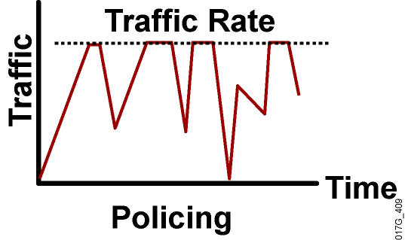
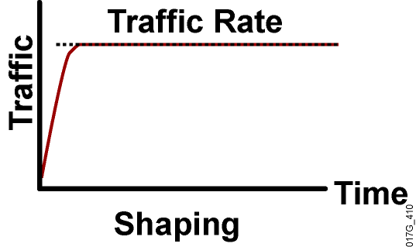
Policing Versus Shaping
Incoming and outgoing directions.
Out-of-profile packets are dropped.
Dropping causes TCP retransmits.
Policing supports packet marking or re-marking.
Outgoing direction only.
Out-of-profile packets are queued until a buffer gets full.
Buffering minimizes TCP retransmits.
Marking or re-marking not supported.
Shaping supports interaction with Frame Relay congestion indication.
Notes:
Policing can be applied to either the inbound or outbound direction, while shaping can be applied only in the outbound direction. Policing drops nonconforming traffic instead of queuing the traffic like shaping. Policing also supports marking of traffic. Traffic policing is more efficient in terms of memory utilization than traffic shaping because no additional queuing of packets is needed.
Both traffic policing and shaping ensure that traffic does not exceed a bandwidth limit, but each mechanism has different impacts on the traffic:
Policing drops packets more often, generally causing more retransmissions of connection-oriented protocols, such as TCP.
Shaping adds variable delay to traffic, possibly causing jitter. Shaping queues excess traffic by holding packets in a shaping queue. Traffic shaping is used to shape the outbound traffic flow when the outbound traffic rate is higher than a configured rate. Traffic shaping smoothes traffic by storing traffic above the configured rate in a shaping queue. Therefore, shaping increases buffer utilization on a router and causes unpredictable packet delays. Traffic shaping can also interact with a Frame Relay network, adapting to indications of Layer 2 congestion in the WAN. For example, if the backward-explicit congestion notification (BECN) bit is received, the router can lower the rate limit to help reduce congestion in the Frame Relay network.

Slide 47
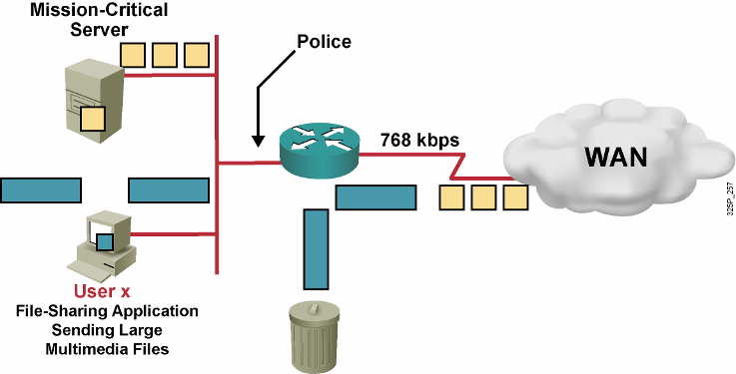
Traffic Policing Example
Do not rate-limit traffic from mission-critical server.
Rate-limit file-sharing application traffic to 56 kbps.
Notes:
Traffic policing divides the shared resource (the upstream WAN link) among many flows. In the example shown, the router Fast Ethernet interface has an input traffic-policing policy applied to it in which the mission-critical server traffic rate is not limited but the user x file-sharing application traffic rate is limited to 56 kbps. All file-sharing application traffic from user x that exceeds the rate limit of 56 kbps will be dropped.

Slide 48
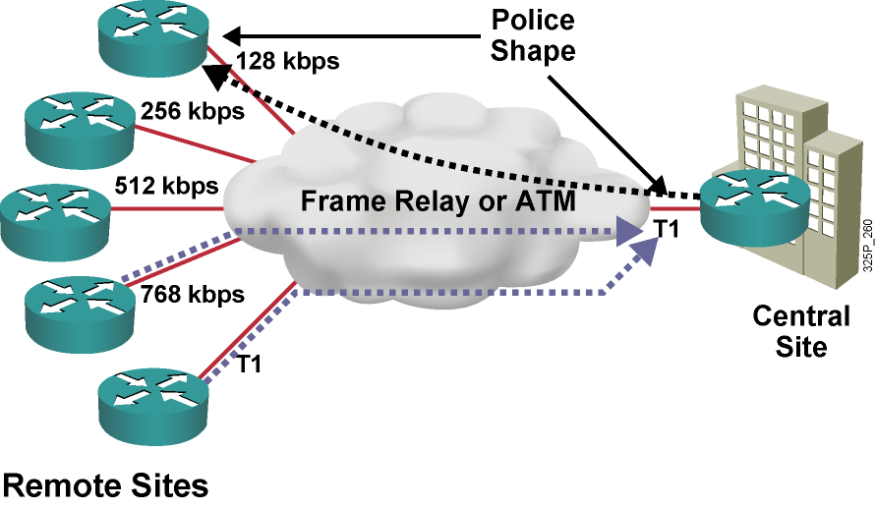
Traffic Policing and Shaping Example
Central to remote site speed mismatch
Remote to central site oversubscription
Both situations result in buffering and in delayed or dropped packets.
Notes:
This example shows two types of speed mismatches:
The central site can have a higher-speed link than the remote site. Thus, traffic shaping can be deployed at the central site router to shape the traffic rate out of the central site router to match the link speed of the remote site. For example, the central router can shape the permanent virtual circuit (PVC) outgoing traffic rate (going to the top remote-site router) to 128 kbps to match that remote-site link speed. At each remote-site router, traffic shaping is also implemented to shape the remote-site outgoing traffic rate to 128 kbps to match the committed information rate (CIR).
The aggregate link speed of all the remote sites can be higher than the central site link speed (oversubscribing the central site link speed). In this case, the remote-site routers can be configured for traffic shaping to avoid oversubscription at the central site. For example, the bottom two remote-site routers can be configured to shape the PVC outgoing traffic rate to 256 kbps to keep the central-site router from being oversubscribed.
On all the links between the central site and the remote sites, traffic policing can be used to prioritize packets and to decide, for instance, whether packets that conform can be configured to be transmitted, packets that exceed can be configured to be sent with a decreased priority, and packets that violate can be configured to be dropped. For example, packets with an IP precedence of 4 that do not exceed 128 kbps are transmitted.

Slide 49
Token Bucket
Mathematical model used by routers and switches to regulate traffic flow.
Tokens represent permission to send a number of bits into the network.
Tokens are put into the bucket at a certain rate by IOS.
Token bucket holds tokens.
Tokens are removed from the bucket when packets are forwarded.
If there are not enough tokens in the bucket to send the packet, traffic conditioning is invoked (shaping or policing).
Notes:
The token bucket is a mathematical model used by routers and switches to regulate traffic flow. The model has two basic components:
Tokens: Each token represents permission to send a fixed number of bits into the network. Tokens are put into a token bucket at a certain rate by Cisco IOS software.
Token bucket: A token bucket has the capacity to hold a specified number of tokens. Each incoming packet, if forwarded, takes tokens from the bucket representing the packet size. If the bucket fills to capacity, newly arriving tokens are discarded. Discarded tokens are not available to future packets. If there are not enough tokens in the token bucket to send the packet, the traffic-conditioning mechanisms may take the following actions:
Wait for enough tokens to accumulate in the bucket (traffic shaping)
Discard the packet (traffic policing)
Using a single token bucket model, the measured traffic rate can conform to or exceed the specified traffic rate. The measured traffic rate is conforming if there are enough tokens in the token bucket to transmit the traffic. The measured traffic rate is exceeding if there are not enough tokens in the token bucket to transmit the traffic.

Slide 50
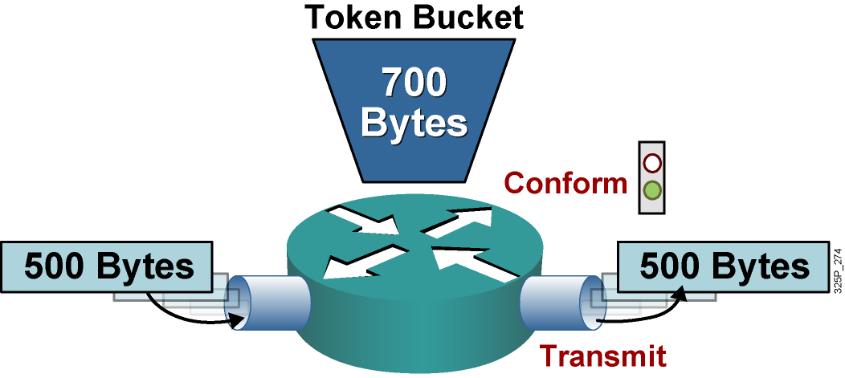
Single Token Bucket
If sufficient tokens are available (conform action):
Tokens equivalent to the packet size are removed from the bucket.
The packet is transmitted.
Notes:
This graphic shows a single token bucket traffic policing implementation.
Starting with a current capacity of 700 bytes worth of tokens accumulated in the token bucket, when a 500-byte packet arrives at the interface, its size is compared to the token bucket capacity (in bytes).
The 500-byte packet conforms to the rate limit (500 bytes is less than 700 bytes), and the packet is forwarded: 500 bytes worth of tokens are taken out of the token bucket, leaving 200 bytes worth of tokens for the next packet.

Slide 51
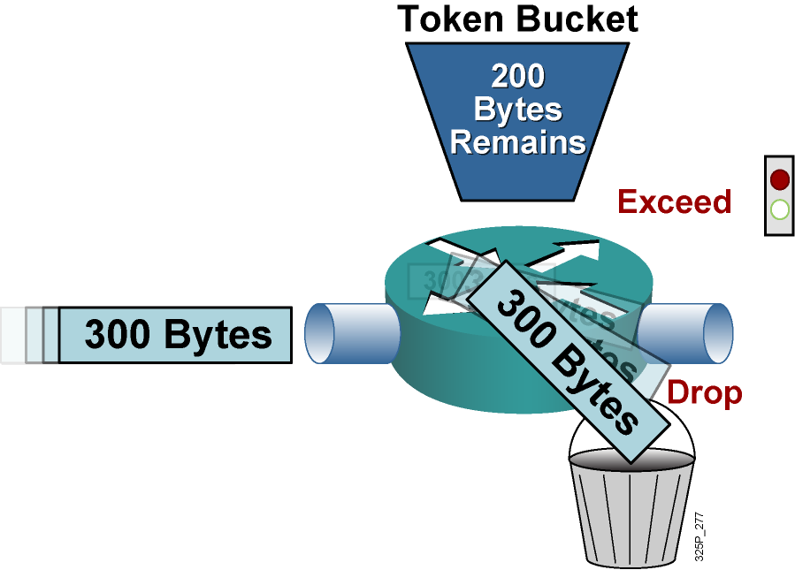
Single Token Bucket Exceed Action
If sufficient tokens are not available (exceed action):
Drop (or mark) the packet.
Notes:
Continuing with the single token bucket example from the previous figure, when the next 300-byte packet arrives immediately after the first packet, no new tokens have been added to the bucket (which is done periodically).
This packet exceeds the rate limit. The current packet size (300 bytes) is greater than the current capacity of the token bucket (200 bytes), and the exceed action is performed.
In traffic policing, the exceed action can be to drop or mark the packet.

Slide 52
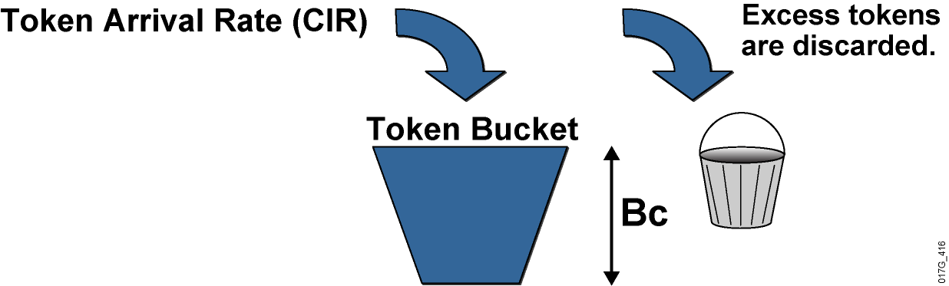
Single Token Bucket Class-Based Policing
Bc is normal burst size.
Tc is the time interval.
CIR is the committed information rate.
CIR = Bc / Tc
Notes:
Token bucket operations rely on parameters such as CIR, committed burst (Bc), and committed time interval (Tc). Bc is known as the normal burst size. The mathematical relationship between CIR, Bc, and Tc is as follows:
CIR (bps) = Bc (bits) / Tc (sec)
With traffic policing, new tokens are added into the token bucket based on the interpacket arrival rate and the CIR. Every time a packet is policed, new tokens are added back into the token bucket. The number of tokens added back into the token bucket is calculated as follows:
(Current Packet Arrival Time – Previous Packet Arrival Time) * CIR
An amount (Bc) of tokens is forwarded without constraint in every time interval (Tc). For example, if 8000 bits (Bc) worth of tokens are placed in the bucket every 250 ms (Tc), the router can steadily transmit 8000 bits every 250 ms if traffic arrives constantly at the router.
CIR (normal burst rate) = 8,000 bits (Bc) / 0.25 seconds (Tc) = 32 kbps
When configuring Cisco IOS class-based traffic policing, it is recommended that you allow Cisco IOS software to automatically calculate the optimal Bc and Tc value based on the configured CIR.
Without any excess bursting capability, if the token bucket fills to capacity (Bc of tokens), the token bucket overflows and newly arriving tokens are discarded. Using the example, in which the CIR is 32 kbps (Bc = 8000 bits and Tc = 0.25 seconds), the maximum traffic rate can never exceed a hard rate limit of 32 kbps.

Slide 53
Cisco IOS Traffic-Policing Mechanism
 | Class-Based Policing
Enable method | Enabled in policy map
Conditions Actions | Conform, exceed, violate Drop, set, transmit
Implementations | Single or dual token bucket, single- or dual-rate policing, multiactions
Notes:
This table lists the characteristics of the class-based traffic-policing mechanisms that are available in Cisco IOS software. Class-based policing is also available on some Cisco Catalyst switches.
Class-based policing supports a single or dual token bucket. Class-based policing also supports single-rate or dual-rate metering and multiaction policing. Multiaction policing allows more than one action to be applied; for example, marking the Frame Relay DE bit and the DSCP value before sending the exceeding traffic.
Class-based policing is configured using the Cisco Modular QoS CLI (MQC), using the police command under the policy map configuration.

Slide 54
Cisco IOS Traffic-Shaping Mechanisms
 | Class-Based Shaping | FRTS
Restriction | Shaper for any subinterface | Shaper for Frame Relay only
Classification | Class-based | Per DLCI or subinterface
Link fragmentation and interleaving | No support for FRF.12 | Supports FRF.12
Frame Relay Support | Understands BECN and FECN | Understands BECN and FECN
Configuration | Supported via MQC | Supported via MQC
Notes:
This table lists two of the traffic-shaping mechanisms available in Cisco IOS software: class-based traffic shaping and FRTS.
Class-based traffic shaping uses the MQC to allow traffic to be shaped per traffic class as defined by the class map. Class-based traffic shaping can be used in combination with class-based weighted fair queuing (CBWFQ), in which the shaped rate is used to define an upper rate limit while the bandwidth statement within the CBWFQ configuration is used to define a minimum rate limit.
FRTS is used to shape Frame Relay traffic only. FRTS allows an individual PVC (data-link connection identifier [DLCI]) to be shaped. FRTS can use priority queuing (PQ), custom queuing (CQ), or weighted fair queuing (WFQ) as the shaping queue and supports only FIFO as the software queue.
FRTS supports FRF.12 Frame Relay fragmentation, while class-based shaping does not support FRF.12 fragmentation for Frame Relay.
Traffic-shaping mechanisms can interact with a Frame Relay network, adapting to indications of Layer 2 congestion in the WAN. For example, if the backward-explicit congestion notification (BECN) bit is received, the router can lower the rate limit to help reduce congestion in the Frame Relay network. And if the forward-explicit congestion notification (FECN) bit is received, the router can generate a test frame with the BECN bit set. This enables the sender to notice congestion even if there is no data traffic flowing back from the receiver to the sender.

Slide 55
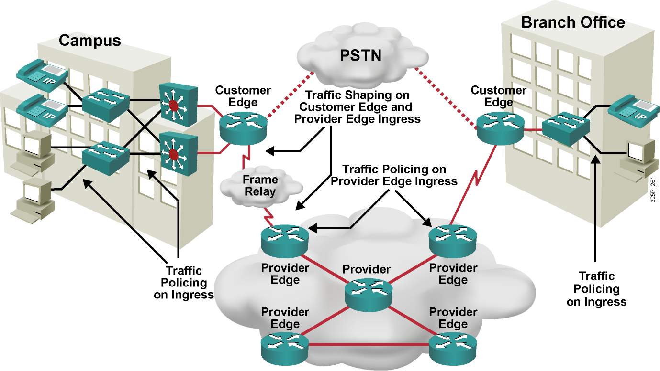
Applying Rate Limiting
Notes:
This example shows how traffic policing is often implemented in an enterprise network. Typically, the access or distribution layer employs traffic policing to limit certain traffic classes before that traffic exits the campus onto the WAN. Traffic shaping is often implemented at the WAN edge when there are speed mismatches or oversubscription.
In a typical service provider network, traffic policing is often implemented inbound at the Provider Edge (PE) router to rate-limit incoming traffic from the Customer Edge (CE) router to ensure that the customer traffic rate is not exceeding the contractual rate. Traffic shaping is often implemented outbound at the Provider Edge and at the Customer Edge to limit the traffic rate between the Provider Edge and Customer Edge and to allow for FRF.12 fragmentation on Frame Relay connections between the Customer Edge and Provider Edge.

Slide 56
Link Efficiency Mechanisms
Link efficiency mechanisms are often deployed on WAN links to increase the throughput and to decrease delay and jitter.
Cisco IOS link efficiency mechanisms include:
Layer 2 payload compression
Header compression
Link Fragmentation and Interleaving (LFI)
Notes:
WAN links can use bandwidth optimizing link efficiency QoS mechanisms such as payload compression, header compression, and link fragmentation and interleaving (LFI). These features are applicable to low-speed WAN interfaces and are emerging for use on high-speed Ethernet interfaces.
Payload compression: Payload compression does create additional bandwidth, because it squeezes packet payloads, and therefore increases the amount of data that can be sent through a transmission resource in a given time period. Payload compression is mostly performed on Layer 2 frames and, as a result, compresses the entire Layer 3 packet.
Header compression: The basis of header compression, like other compression methods, is the elimination of redundancy. This applies especially to often-repeated protocol headers.
LFI: LFI is a Layer 2 technique in which large frames are broken into small, equal-sized fragments and transmitted over the link in an interleaved fashion. The three primary LFI mechanisms supported by Cisco are as follows:
Multilink PPP (MLP): Used on PPP links
FRF.12: Used on Voice over IP over Frame Relay (VoIPovFR) links
FRF.11 Annex C: Used on Voice over Frame Relay (VoFR) links

Slide 57
Compression
Data compression works by the identification of patterns in a stream of data.
Basic elements of compression:
Remove redundancy as much as possible.
There is a theoretical limit, known as Shannon's limit.
Many compression algorithms exist, for different purposes:
MPEG compression for video
Huffmann compression for text and software
LZ compression, used in Stacker compression
Two methods of compression are used:
Hardware compression
Software compression
Notes:
Data compression works by identifying patterns in streams of data, and then chooses a more efficient method to represent the same information. Essentially, a compression algorithm removes as much redundancy as possible. The compression ratio measures the efficiency and effectiveness of a compression scheme—the ratio of the size of uncompressed data to compressed data. A compression ratio of 2:1 (which is relatively common) means that the compressed data is half the size of the original data.
Several compression algorithms exist. Some algorithms take advantage of a specific medium and the redundancies found in it. For example, the MPEG standard takes advantage of the relatively small difference between one frame and another in video data.
One of the most important concepts in compression theory is that there is a theoretical limit, known as Shannon's limit, which describes how far a given source of data can be compressed. Modern compression algorithms coupled with the fast processors available today allow compression to approach Shannon’s limit.
Hardware compression and software compression refer to the site in the router to which the compression algorithm is applied. In software compression, compression is implemented in the main CPU as a software process. In hardware compression, the compression computations are off-loaded to a secondary hardware module. This frees the central CPU from the computationally intensive task of calculating compression.

Slide 58
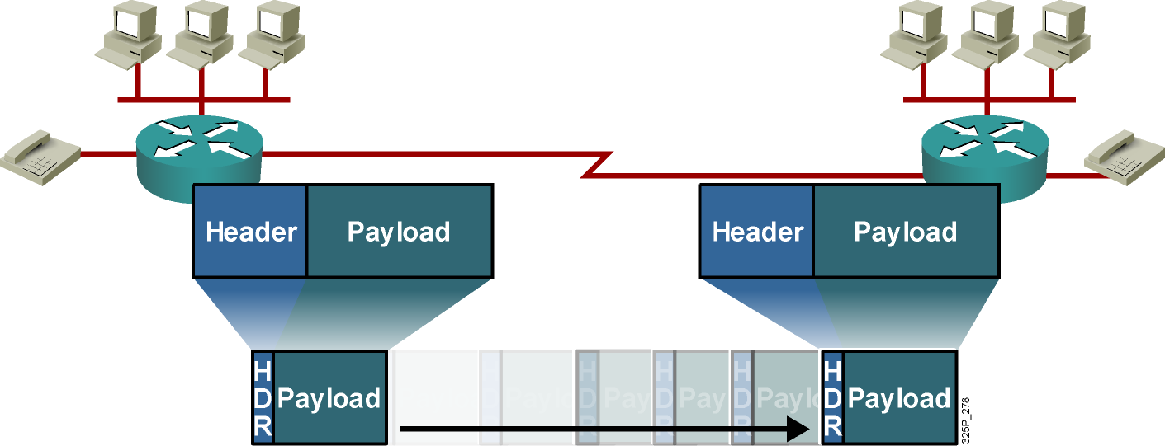
Payload and Header Compression
Payload compression reduces the size of the payload.
Header compression reduces the header overhead.
Compression increases throughput and decreases latency.
Notes:
Payload compression squeezes payloads, either the Layer 2 payload or the Layer 3 payload. With Layer 2 payload compression, the Layer 2 header remains intact, but its payload (Layer 3 and above) is compressed. With Layer 3 payload compression, Layer 2 and 3 headers remain intact. Payload compression increases the throughput and decreases the latency in transmission, because smaller packets (with compressed payloads) take less time to transmit than the larger, uncompressed packets. Layer 2 payload compression is performed on a link-by-link basis, whereas Layer 3 payload compression is generally used on a session-by-session basis.
Header compression methods work by not transmitting repeated information in packet headers throughout a session. The two peers on a PPP Layer 2 connection (a dialup link) agree on session indices that index a dictionary of packet headers. The dictionary is built at the start of every session and is used for all subsequent (noninitial) packets. Only changing, or nonconstant, parameters in the headers are actually sent along with the session index.
Header compression cannot be performed across multiple routers because routers need full Layer 3 header information to be able to route packets to the next hop.

Slide 59
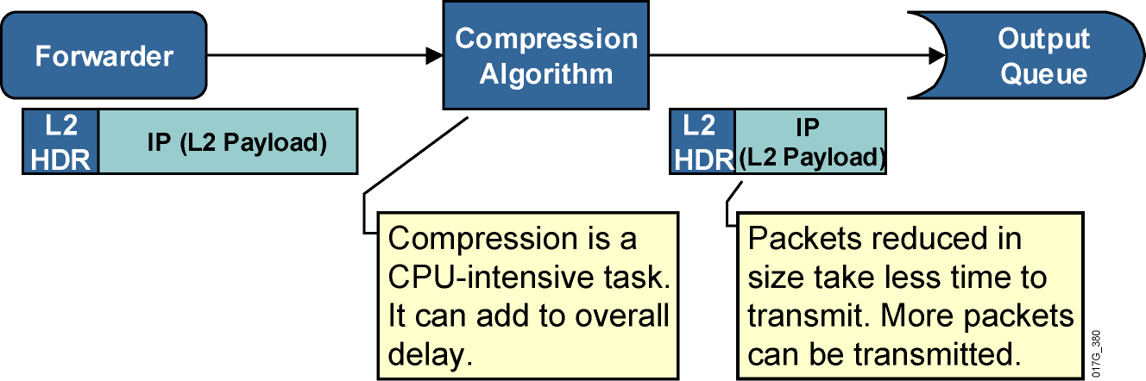
Layer 2 Payload Compression
Layer 2 payload compression reduces the size of the frame payload.
Entire IP packet is compressed.
Software compression can add delay because of its complexity.
Hardware compression reduces the compression delay.
Serialization delay is reduced; overall latency might be reduced.
Notes:
When a router forwards a packet, the packet is subjected to the Layer 2 compression method after it has been encapsulated at the output. The compression method squeezes the payload of the Layer 2 frame (the entire Layer 3 packet), and transmits the packet on the interface.
Layer 2 payload compression is a CPU-intensive task and can add per-packet compression delay because of the application of the compression method to each frame. The serialization delay, however, is reduced, because the resulting frame is smaller. Serialization delay is the fixed delay that is required to clock the frame onto the network interface. Depending on the complexity of the Layer 2 payload compression algorithm, overall latency might be reduced, especially on low-speed links.
Layer 2 payload compression involves the compression of the payload of a Layer 2 WAN protocol, such as PPP, Frame Relay, High-Level Data Link Control (HDLC), X.25, and Link Access Procedure, Balanced (LAPB). The Layer 2 header is untouched by the act of compression. However, the entire contents of the payload (which include higher-layer protocol headers) are compressed. They are compressed using either a form of the Stacker algorithm (based on the industry standard LZ algorithm) or the Predictor algorithm, which is an older algorithm that is mostly used in legacy configurations.

Slide 60
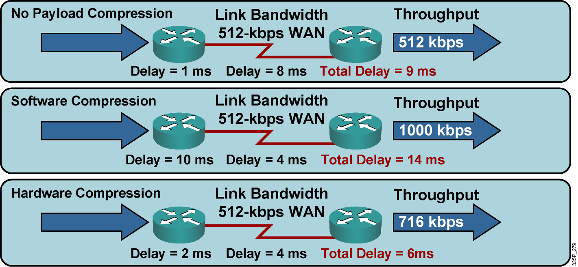
Layer 2 Payload Compression Results
Compression increases throughput and decreases delay.
Use hardware compression when possible.
Examples are Stacker, Predictor, and MPPC.
Notes:
If no compression is used, throughput is limited by the link bandwidth, and the average delay is influenced by forwarding or buffering delay, serialization, and propagation delay.
If compression is enabled—even if the serialization delay is now shorter because the frame is smaller—the compression or decompression delay may increase the overall latency between the two hops. The perceived throughput is generally increased because the size of the Layer 2 payload is reduced, allowing more Layer 2 frames to be sent through a transmission resource in a given time period. Throughput is limited by the effectiveness of the Layer 2 payload-compression algorithm and may be significantly higher than the link bandwidth limit.
If hardware-assisted Layer 2 payload compression is used, compression or decompression delays may become insignificant compared to forwarding and serialization delays, and overall latency may decrease.

Slide 61
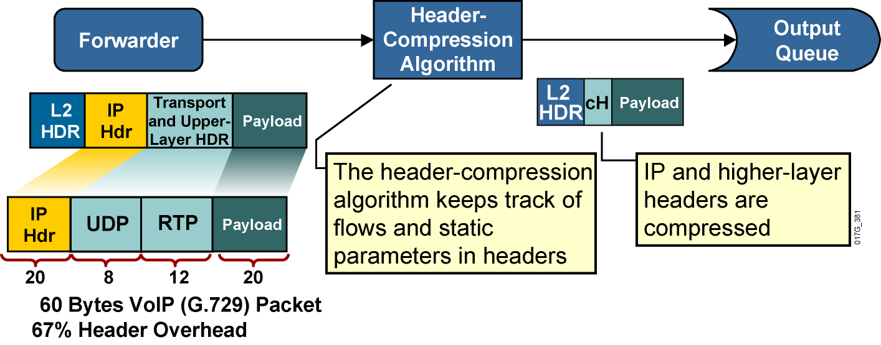
Header Compression
.
.
Notes:
Header compression increases throughput and reduces delay by compressing the protocol headers. Header compression is most useful for applications that generate small payloads because the protocol headers of such applications use a significant percentage of bandwidth on a link relative to their payload.
When header compression is applied on a TCP/IP header, some of the redundant fields in the header of a TCP/IP connection are removed. Header compression keeps a copy of the original header on either side of the link, removes the entirely redundant fields, and differentially codes the remaining fields in order to allow the compression of 40 bytes of header to an average of 5 bytes. This process uses a very specific algorithm designed around the constant structure of the TCP/IP header. It does not touch the payload of the TCP packet in any way.
TCP and RTP header compression applies to all TCP and RTP flows. For example, if TCP compression is enabled on a link, there is no mechanism to restrict its function to specific application types. TCP header compression for bulk data transfer yields little bandwidth savings. Class-based TCP header compression can be performed on specific traffic classes, such as the Telnet traffic class.
Class-based TCP header compression allows configuring RTP or TCP IP header compression on a per-class basis, when a class is configured within a policy map.

Slide 62
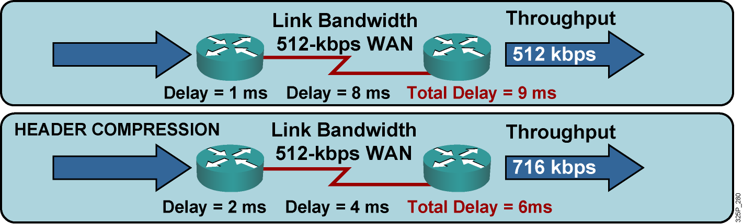
Header Compression Results
Header compression increases compression delay and reduces serialization delay.
Notes:
This graphic compares two throughput and latency scenarios on a WAN link.
If header compression is not used, throughput is limited by the link bandwidth, and the average delay is influenced only by forwarding or buffering delay, serialization, and propagation delay.
If header compression is enabled, compressing the protocol headers causes the packet to become smaller, allowing more packets to be sent through a transmission resource in a given time period to increase throughput. Because the packet size is smaller, the serialization delay also becomes smaller, reducing the overall delay. Header compression has a low compression delay and a relatively low CPU overhead and is recommended on links slower than 2 Mbps.

Slide 63
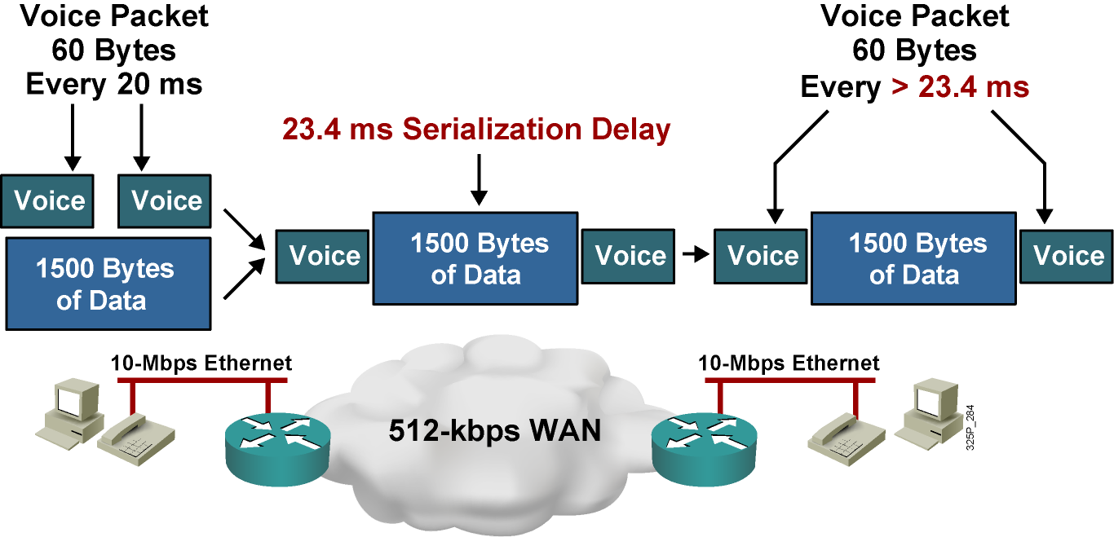
Large Packets “Freeze Out” Voice on Slow WAN Links
Problems:
Excessive delay due to slow link and MTU-sized (large) packets
Jitter (variable delay) due to variable link utilization
Notes:
In considering delay between two hops in a network, queuing delay in a router must be taken into account because it may be comparable to, or even exceed, serialization and propagation delay on a link. In an empty network, an interactive or voice session experiences low or no queuing delay, because the session does not compete with other applications on an interface output queue. Also, the small delay does not vary enough to produce significant jitter on the receiving side.
In a congested network, interactive data and voice applications compete in the router queue with other applications. Queuing mechanisms may prioritize voice traffic in the software queue, but the hardware queue (TxQ) always uses a FIFO scheduling mechanism. After packets of different applications leave the software queue, the packets will mix with other packets in the hardware queue, even if their software queue processing was expedited. Thus, a voice packet may be immediately sent to the hardware queue where two large FTP packets are waiting for transmission. The voice packet must wait until the FTP packets are transmitted, thus producing an unacceptable delay in the voice path. Because links are used variably, the delay varies with time and may produce unacceptable jitter in jitter-sensitive applications such as voice.
In the example shown here, the serialization delay of a 1500-byte packet over a 512-kbps link will be 24.3 ms. For VoIP traffic, the maximum recommended one-way, end-to-end delay is 150 ms. Therefore, having a 1500-byte packet ahead of a VoIP packet in the hardware queue on a 512-kbps link can cause the end-to-end delay of the voice packet to be over the budget of 24.3 ms.

Slide 64
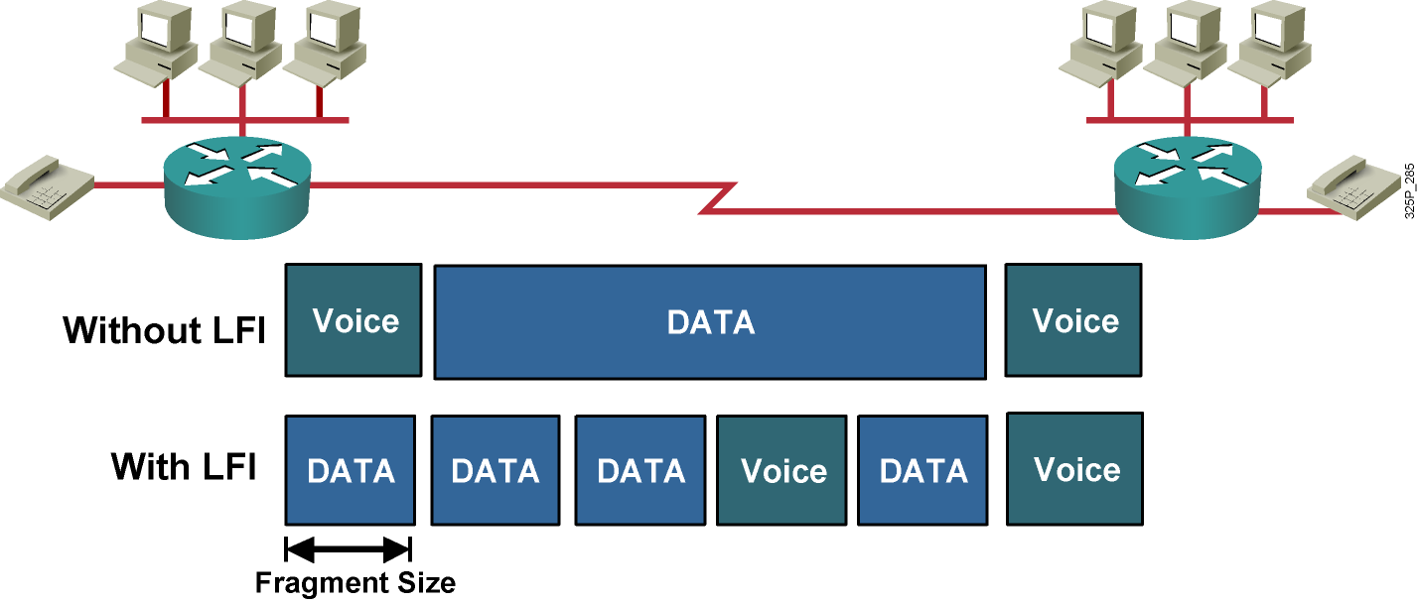
Link Fragmentation and Interleaving (LFI)
LFI reduces the delay and jitter of small packets (such as VoIP).
Notes:
The use of a hybrid queuing method such as low latency queuing (LLQ) can provide low latency and low jitter for VoIP packets while servicing other data packets in a fair manner. But, even if VoIP packets are always sent to the front of the software queue, there is still the issue of serialization delay. A large packet may be on its way out of the hardware queue, which uses FIFO. When a VoIP packet is sent to the front of the software queue, the serialization of the large packet in the hardware transmit queue can cause the VoIP packet to wait for a long time before it can be transmitted out.
The solution is to fragment the large packets so that they never cause a VoIP packet to wait for more than a predefined amount of time. The VoIP packets must also be allowed to transmit in between the fragments of the larger packets (interleaving), or there will be no point in doing the fragmenting.
When you are configuring the proper fragment size to use on a link, a typical goal is to have a maximum serialization delay of around 10 to 15 ms. Depending on the LFI mechanisms being configured, the fragment size is either configured in bytes or in milliseconds.

Slide 65
Applying Link Efficiency Mechanisms
Identify bottlenecks in the network.
Calculate Layer 2 and Layer 3 overhead.
Decide which type of compression to use, such as TCP header compression.
Enable compression on WAN interfaces.
Notes:
Use the following guidelines for applying link efficiency mechanisms:
Identify slow links to help determine where the bottlenecks in the network are located and decide how to apply link efficiency mechanisms at the appropriate interfaces.
Calculate the Layer 2 and Layer 3 overhead for each media type that will transport the business-critical traffic. This process will help you choose the correct compression type.
Decide which type of compression should be used.
Enable compression on the WAN interfaces.

Slide 66
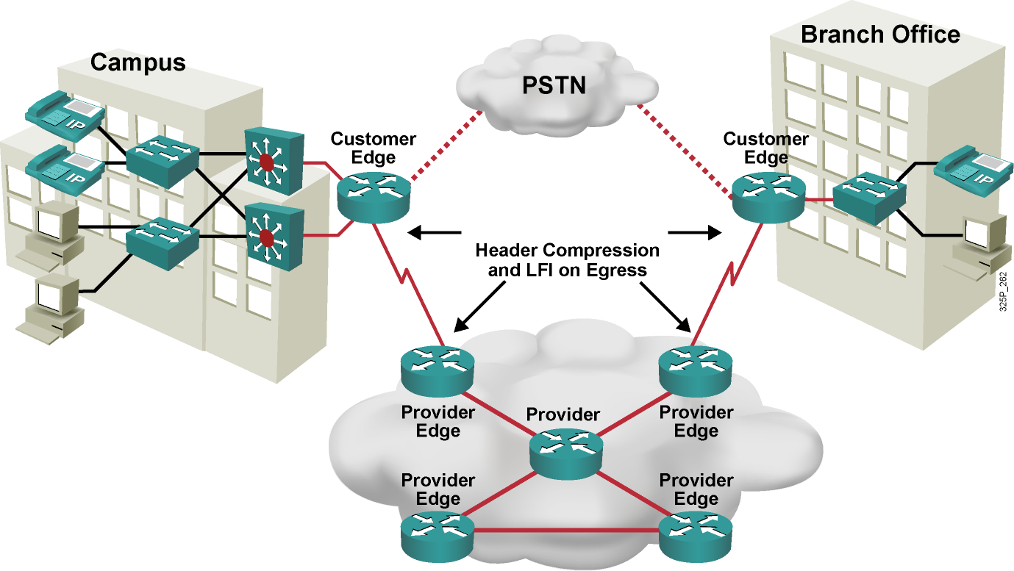
Network Using LFI
Notes:
This graphic shows an example of a network using LFI.
Header compression and LFI are typically configured at the WAN edge for WAN links below T1 or E1 speeds to optimize the use of the WAN link and to prevent long serialization delay.
Layer 2 payload compression is less commonly deployed on WAN links, especially without the use of hardware-assisted payload compression. In this case, use TCP and RTP compression, as well as LFI mechanisms, because this network carries converged network traffic.

Slide 67
Module 4: Implement the DiffServ QoS Model
Lesson 4.9: Implementing QoS Preclassify

Slide 68
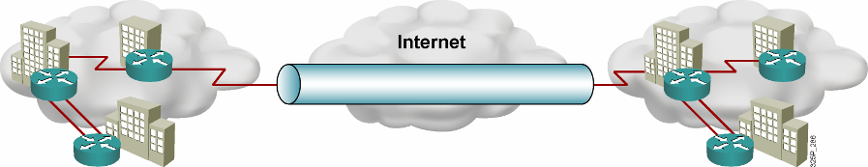
Virtual Private Networks
A VPN carries private traffic over a public network using advanced encryption and tunnels to protect:
Confidentiality of information
Integrity of data
Authentication of users
VPN Types:
Remote access:
Client-initiated
Network access server
Site-to-site:
Intranet
Extranet
Notes:
A virtual private network (VPN) is defined as network connectivity deployed on a shared (public) infrastructure with the same policies and security as a private network.
A VPN is established between two end systems or between two or more networks. A VPN can be built using tunnels, encryption, or both, at essentially any layer of the Open System Interconnection (OSI) protocol stack. A VPN is an alternative WAN infrastructure that replaces or augments private networks that use leased-line or enterprise-owned Frame Relay networks.
VPNs provide three critical functions:
Confidentiality (encryption): The sender can encrypt the packets before transmitting them across a network, prohibiting anyone from eavesdropping on the communication. If intercepted, the communication cannot be read.
Data integrity: The receiver can verify that the data was transmitted through the Internet without being changed or altered in any way.
Origin authentication: The receiver can authenticate the source of the packet, guaranteeing and certifying the source of the information.
There are two types of remote-access VPNs:
Client-initiated: Remote users use clients to establish a secure tunnel across an Internet service provider (ISP)-shared network to the enterprise.
Network access server (NAS)-initiated: Remote users dial in to an ISP. The NAS establishes a secure tunnel to the enterprise private network that might support multiple remote user-initiated sessions.
Site-to-site VPNs include two main types:
Intranet VPNs: Connect corporate headquarters, remote offices, and branch offices over a public infrastructure
Extranet VPNs: Link customers, suppliers, partners, or communities of interest to a corporate intranet over a public infrastructure

Slide 69
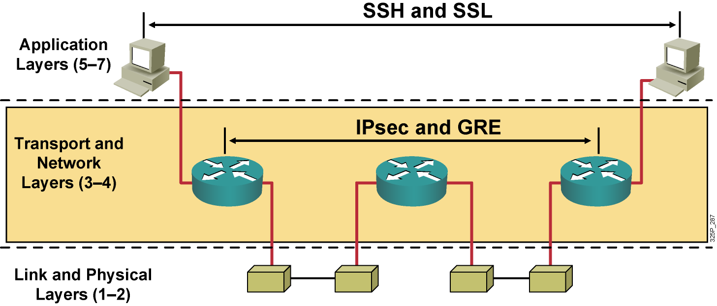
Encryption Overview
Notes:
Various methods for VPN protection are implemented on different layers. Providing privacy and other cryptographic services at the application layer was very popular in the past, and in some situations is still done today. For example, Secure Shell Protocol (SSH) offers Internet-based data-security technologies and solutions, especially for cryptography and authentication products.
However, application-layer security is application-specific, and protection methods must be implemented anew in every application.
Some standardization has been successful at Layer 4 (transport) of the OSI model, with protocols such as Secure Socket Layer (SSL) providing privacy, authenticity, and integrity to TCP-based applications. SSL is popular in modern e-commerce sites, but it fails to address the issues of flexibility, ease of implementation, and application independence.
Protection at lower levels of the OSI stack, especially the data link layer, was also used in early communication systems, because it provides protocol-independent protection on specific untrusted links. However, data link layer protection is expensive to deploy on a large scale (protecting every link separately), potentially allowing man-in-the-middle attacks (the hijacking of a network session) on intermediate stations (routers).
Because of these limitations, Layer 3 has become the most popular level on which to apply cryptographic protection to network traffic.

Slide 70
VPN Protocols
Protocol | Description | Standard
L2TP | Layer 2 Tunneling Protocol | Based on Cisco Layer 2 Forwarding (L2F) and Microsoft's Point-to-Point Tunneling Protocol (PPTP), RFC 3631
GRE | Generic Routing Encapsulation | RFC 1701, RFC 1702, RFC 2748
IPsec | Internet Protocol Security | RFC 4301
Notes:
The table describes three VPN tunneling protocols: Layer 2 Tunneling Protocol (L2TP), generic routing encapsulation (GRE), and IPsec:
L2TP: L2TP acts like a data link layer (layer 2 of the OSI model) protocol for tunneling network traffic between two peers over an existing network (usually the Internet). L2TP is in fact a Layer 5 protocol session layer, and uses the registered UDP port 1701. The entire L2TP packet, including payload and L2TP header, is sent within a UDP datagram.
GRE: This multiprotocol transport encapsulates IP and any other protocol packets inside IP tunnels. With GRE tunneling, a Cisco router at each site encapsulates protocol-specific packets in an IP header, creating a virtual point-to-point link to Cisco routers at other ends of an IP cloud where the additional IP header is stripped off. GRE does not provide encryption and can be monitored with a protocol analyzer.
IPsec: IPsec is the choice for secure corporate VPNs. IPsec is a framework of open standards that provides data confidentiality, data integrity, and data authentication between participating peers. IPsec provides security services to handle negotiation of protocols and algorithms based on local policy and to generate encryption and authentication keys.

Slide 71
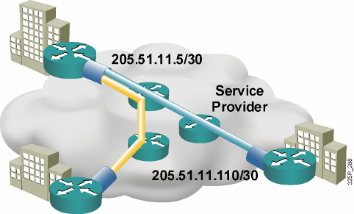
QoS Preclassify
VPNs are growing in popularity.
The need to classify traffic within a traffic tunnel is also gaining importance.
QoS preclassify is a Cisco IOS feature that allows packets to be classified before tunneling and encryption occur.
Preclassification allows traffic flows to be adjusted in congested environments.
Notes:
Quality of service (QoS) preclassify is designed for tunnel interfaces. When the feature is enabled, the QoS features on the output interface classify packets before encryption, allowing traffic flows to be managed in congested environments. The result is more effective packet tunneling.
The QoS preclassify feature provides a solution for making Cisco IOS QoS services operate in conjunction with tunneling and encryption on an interface. Cisco IOS software can classify packets and apply the appropriate QoS service before data is encrypted and tunneled. This allows service providers and enterprises to treat voice, video, and mission-critical traffic with a higher priority across service provider networks while using VPNs for secure transport.

Slide 72
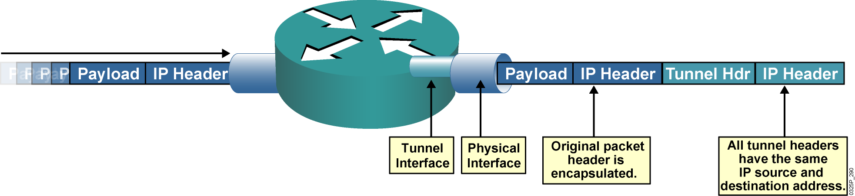
QoS Preclassify Applications
When packets are encapsulated by tunnel or encryption headers, QoS features are unable to examine the original packet headers and correctly classify packets.
Packets traveling across the same tunnel have the same tunnel headers, so the packets are treated identically if the physical interface is congested.
Notes:
When packets are encapsulated by a tunneling or encryption protocol, the original packet header is no longer available for examination. From the QoS perspective, providing differentiated levels of service is extremely difficult without the ability to examine the original packet header. The QoS markers normally found in the header of the IP packet must also be visible in the tunnel packet header, regardless of the type of tunnel in use.
IPsec and GRE are the two primary tunneling protocols relevant to VPNs.

Slide 73
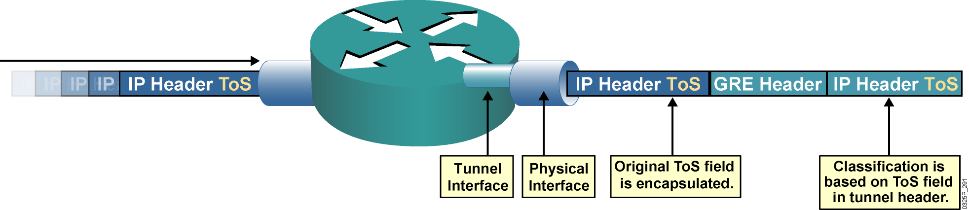
GRE Tunneling
ToS classification of encapsulated packets is based on the tunnel header.
By default, the ToS field of the original packet header is copied to the ToS field of the GRE tunnel header.
GRE tunnels commonly are used to provide dynamic routing resilience over IPsec, adding a second layer of encapsulation.
Notes:
Cisco offers support for encapsulation of data using either IPsec or GRE. GRE tunnels allow any protocol to be tunneled in an IP packet. In either of these scenarios, Cisco IOS software defaults to copying the IP type of service (ToS) values from the packet header into the tunnel header. This feature allows the ToS bits to be copied to the tunnel header when the router encapsulates the packets.
GRE tunneling allows routers between GRE-based tunnel endpoints to see the packet marking, improving the routing of premium service packets. Cisco IOS QoS technologies such as policy routing, weighted fair queuing (WFQ), and weighted random early detection (WRED) can operate on intermediate routers between GRE tunnel endpoints.
GRE tunnels are commonly used to provide dynamic routing resilience over IPsec. Normal IPsec configurations cannot transfer routing protocols, such as Enhanced Interior Gateway Routing Protocol (EIGRP) and Open Shortest Path First (OSPF), or non-IP traffic, such as Internetwork Packet Exchange (IPX) and AppleTalk.

Slide 74
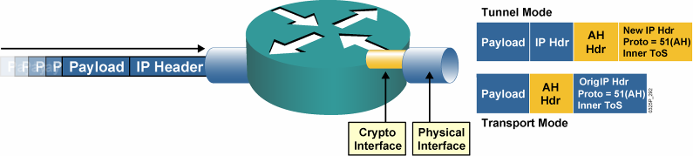
IPsec AH
IPsec AH is for authentication only and does not perform encryption.
With tunnel mode, the ToS byte value is copied automatically from the original IP header to the tunnel header.
With transport mode, the original header is used, and therefore the ToS byte is accessible.
Notes:
IPsec does not define the specific security algorithms to use; rather, IPsec provides an open framework for implementing industry-standard algorithms.
Authentication Header (AH), a key protocol in the IPsec (Internet Security) architecture, provides connectionless integrity and data origin authentication for IP datagrams, and provides protection against replays. AH can also provide nonrepudiation.
The Internet Assigned Numbers Authority (IANA) has assigned protocol number 51 to AH. Thus, in the presence of an AH header with both tunnel mode and transport mode, the IP header uses a value of 51 in the protocol field.
This graphic illustrates how the ToS is used with the AH protocol.
IPsec AH may be applied alone, in combination with the IP Encapsulating Security Payload (ESP), or in a nested fashion by using tunnel mode. With tunnel mode, the ToS byte value is copied automatically from the original IP header to the tunnel header.

Slide 75
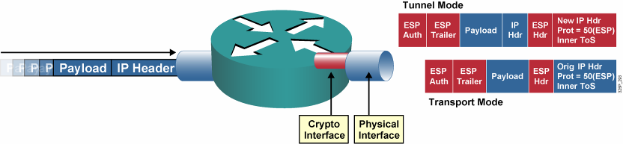
IPsec ESP
IPsec ESP supports both authentication and encryption.
IPsec ESP consists of an unencrypted header followed by encrypted data and an encrypted trailer.
With tunnel mode, the ToS byte value is copied automatically from the original IP header to the tunnel header.
Notes:
Encapsulating Security Payload (ESP) is a key protocol in the IPsec architecture, designed to provide a mix of security services in IPv4 and IPv6. ESP can provide both encryption and authentication. ESP seeks to provide confidentiality and integrity by encrypting data to be protected and placing the encrypted data in the data portion of the ESP. Depending on the user's security requirements, this mechanism may be used to encrypt either a transport-layer segment (e.g., TCP, UDP, ICMP, IGMP) or an entire IP datagram. Encapsulating the protected data is necessary to provide confidentiality for the entire original datagram.
As with AH, ESP supports SHA and MD5 hash algorithms for authentication. ESP supports Data Encryption Standard (DES) and Triple-DES (3DES) encryption protocols. The ESP header is at least 8 bytes. The Internet Assigned Numbers Authority (IANA) has assigned protocol number 50 to ESP.
With tunnel mode, the ToS byte value is copied automatically from the original IP header to the tunnel header.

Slide 76
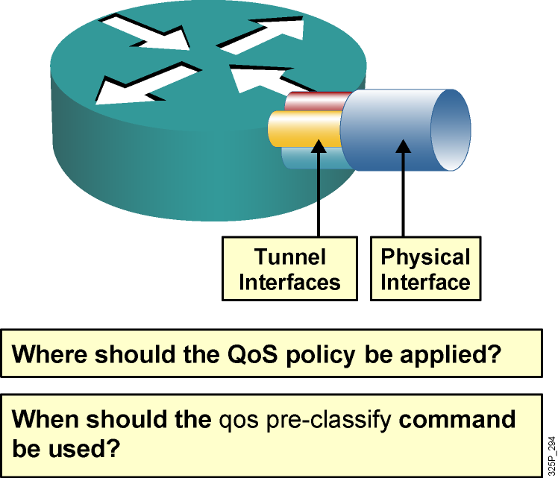
QoS Preclassification Deployment Options
Tunnel interfaces support many of the same QoS features as physical interfaces.
In VPN environments, a QoS service policy can be applied to the tunnel interface or to the underlying physical interface.
The decision about whether to configure the qos preclassify command depends on which header is used for classification.
Notes:
Classification defines the process of matching one or more fields in a packet header at Layer 2, 3, or 4 and then placing that packet in a group or class of traffic. Using packet classification, network traffic can be partitioned into multiple priority levels or classes of service.
When configuring IPsec with GRE, the simplest classification approach is to match on IP precedence or differentiated services code point (DSCP) values. In addition, with the ToS byte preservation feature, the router automatically copies the ToS header value from the original IP packet to the encapsulating IP header when using IPsec in tunnel mode.
ToS byte preservation also applies to AH. ESP in transport mode retains the original IP header, and the original ToS value is transmitted even without ToS byte preservation. If packets arrive at the router without set IP precedence or DSCP values, class-based marking is used to re-mark the packet headers before encryption or encapsulation. When the packets reach the egress interface, the QoS output policy can match and act on the re‑marked values.
Alternatively, traffic may need to be classified based on values other than IP precedence or DSCP. For example, packets may need to be classified based on IP flow or Layer 3 information, such as source and destination IP address. To do so, use the QoS for VPNs feature enabled with the qos pre-classify command.

Slide 77
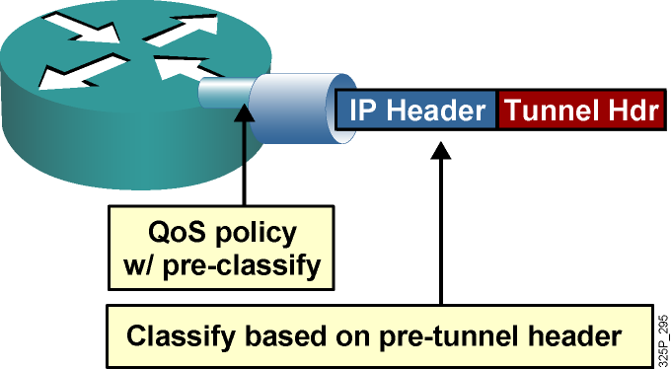
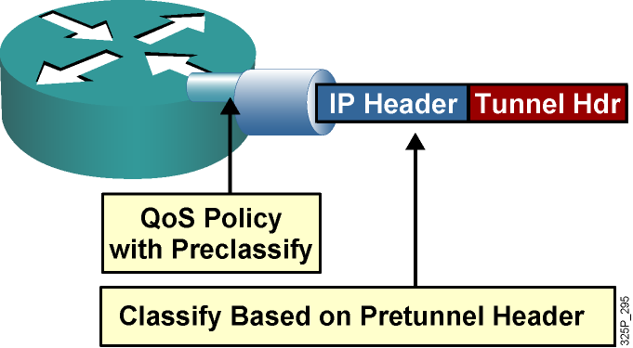
QoS Preclassification IPsec and GRE Configuration
QoS preclassify allows access to the original IP header values.
QoS preclassify is not required if classification is based on the original ToS values since the ToS value is copied by default to a new header.
IPsec and GRE configuration:
!
crypto map static-crypt 1 ipsec-isakmp
qos pre-classify
set peer ….etc
!
interface Tunnel 0
etc..
qos pre-classify
crypto map static-crypt
!
interface Ethernet 0/1
service-policy output minbwtos
crypto map static-crypt
!
Note: ToS byte copying is done by the tunneling mechanism and NOT by the qos pre-classify command.
Notes:
The qos pre-classify command mechanism allows Cisco routers to make a copy of the inner IP header and to run a QoS classification before encryption, based on fields in the inner IP header.
If the classification policy matches on the ToS byte, it is not necessary to use the qos pre-classify command, because the ToS value is copied to the outer header by default. In addition, a simple QoS policy that sorts traffic into classes based on IP precedence can be created. However, differentiating traffic within a class and separating it into multiple flow-based queues requires the qos pre-classify command.
You can apply a service policy to either the tunnel interface or to the underlying physical interface. The decision about where to apply the policy depends on the QoS objectives and on which header you need to use for classification, as follows:
Apply the policy to the tunnel interface without qos pre-classify when you want to classify packets based on the pretunnel header.
Apply the policy to the physical interface without qos pre-classify when you want to classify packets based on the post-tunnel header. In addition, apply the policy to the physical interface when you want to shape or police all traffic belonging to a tunnel and the physical interface supports several tunnels.
Apply the policy to an interface and enable qos pre-classify when you want to classify packets based on the pretunnel header.

Slide 78
Configuring QoS Preclassify
router(config-if)#
qos pre-classify
Enables the QoS preclassification feature.
This command is restricted to tunnel interfaces, virtual templates, and crypto maps.
GRE Tunnels
router(config)# interface tunnel0
router(config-if)# qos pre-classify
IPSec Tunnels
router(config)# crypto map secured-partner
router(config-crypto-map)# qos pre-classify
Notes:
This graphic shows the command syntax
The qos pre-classify Cisco IOS command enables the QoS preclassification feature.
The qos pre-classify command can be applied to a tunnel interface, a virtual template interface, or a crypto map.

Slide 79
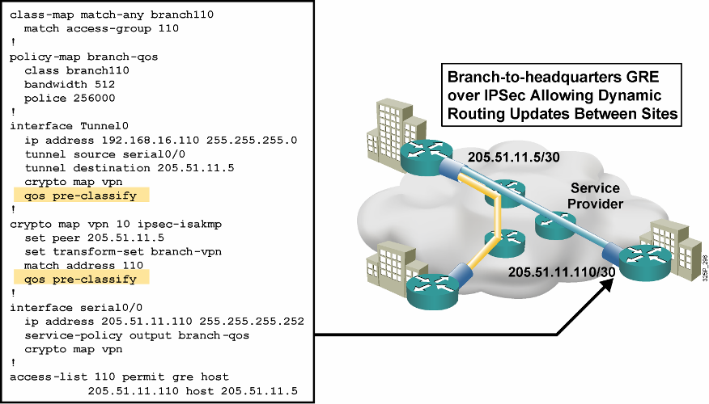
QoS Preclassify: Example
Notes:
This example shows the configuration of the qos pre-classify command.
On the serial0/0 interface on the branch router, there is an outgoing service policy that sets the bandwidth of the interface at 256 kbps and policing at a rate of 512 kbps. This policy is applied to any match in the class map branch 110.
A traffic tunnel has been built on interface serial0/0 (whose destination is the headquarters for this branch). It is on this traffic tunnel that QoS preclassification has been configured.
The example configuration also shows that QoS preclassify has been successfully enabled on the crypto map named “vpn.” This crypto map has also been applied to serial0/0. If QoS preclassify is enabled only on the crypto map and not on the tunnel interface, the router will see one flow only, the GRE tunnel (protocol 47), rather than the multiple flows requiring the benefits of QoS which are “within” the GRE tunnel.

Slide 80
Module 4: Implement the DiffServ QoS Model
Lesson 4.10: Deploying End-to-End QoS

Slide 81
QoS SLAs
QoS SLAs provide contractual assurance for meeting the traffic QoS requirements.
Two major activities:
negotiate the agreement
verify compliance
QoS SLAs typically provide contractual assurance for parameters such as:
Delay (fixed and variable)
Jitter
Packet loss
Throughput
Availability
Notes:
A service level agreement (SLA) stipulates the delivery and pricing of service levels and spells out penalties for shortfalls. SLAs can cover an assortment of data services, such as Frame Relay, leased lines, Internet access, web hosting, and so on. The best way to understand an SLA is to break it into two activities:
Negotiating the technology agreement
Verifying compliance with the agreement
A quality of service (QoS) SLA typically provides contractual assurance for parameters such as delay, jitter, packet loss, throughput, and availability.
With the rapid growth of new multimedia real-time applications such as IP telephony, web conferencing, and e-learning, IP QoS SLAs are becoming increasingly important for enterprise networks.

Slide 82
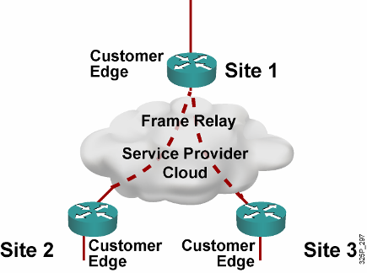
Enterprise Network with Traditional Layer 2 Service—No QoS
SP sells the customer a Layer 2 service.
SP provides point-to-point SLA from the SP.
But, the enterprise WAN is likely to get congested.
IP QoS is required for voice, video, data integration.
This SP is not involved in IP QoS, so ….
Notes:
This graphic illustrates an example in which a SP may provide only Layer 2 services to the enterprise customer.
The Customer Edge routers at the various customer sites are interconnected by Frame Relay virtual circuits (VCs). These VCs can be fully meshed, partially meshed, or set up as hub and spokes, depending on the customer requirements.
In this environment, the SP is responsible only for the end-to-end Layer 2 VC connections. The SP provides only a point-to-point SLA guarantee for each VC connection and is not involved with providing IP QoS to the customer.
To provide IP QoS for voice, video, and data integration over Frame Relay VCs, the customer must configure the proper QoS mechanisms, such as traffic shaping, low latency queuing (LLQ), FRF.12, and compressed Real-Time Transport Protocol (cRTP) at the WAN Customer Edge routers, because the Frame Relay WAN link is likely to become congested.

Slide 83
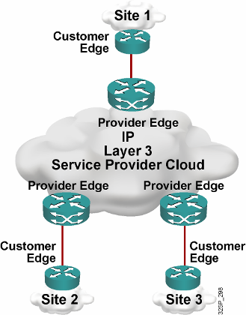
Enterprise Network with IP Service
Customer buys Layer 3 service from a different SP.
There is a point-to-cloud SLA from SP for conforming traffic.
Enterprise WAN is still likely to get congested.
But, this time the SP is involved in IP QoS.
Notes:
In this second example, another SP offers Layer 3 services to the enterprise customer. The Customer Edge routers at the various customer sites connect to the Provider Edge of the SP router. From a particular customer site perspective, every IP address that is not located on-site is reachable via the SP IP backbone network.
In this environment, the SP can provide value-added IP services to the customer by providing SLAs for the conforming traffic from the customer. An SLA can, for example, divide customer traffic at the network edge into controlled latency, controlled load 1, and controlled load 2 classes and then provide IP QoS assurances to each traffic class conforming to the contractual rate over a Differentiated Services (DiffServ) IP backbone. For all nonconforming (exceeding) traffic, the SP can re-mark and deliver all nonconforming traffic with best-effort service.

Slide 84
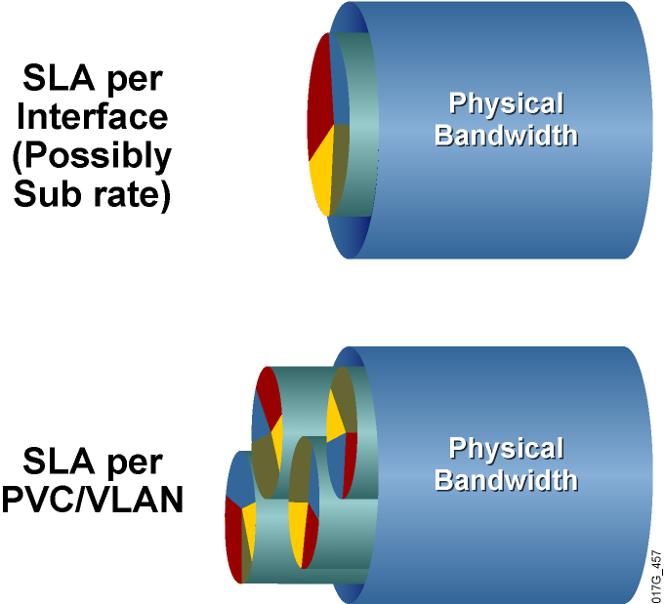
SLA Structure
SLA typically includes between three and five classes.
Real-time traffic gets fixed bandwidth allocation.
Data traffic gets variable bandwidth allocation with minimum guarantee.
Notes:
The typical IP QoS SLA offered by most SPs often includes three to five traffic classes; for example, a real-time traffic class, a mission-critical data traffic class, one or two other data traffic classes, and a best-effort traffic class.
The SLA for the real-time traffic class should be guaranteed a fixed maximum bandwidth, while the data traffic classes should be guaranteed a minimum bandwidth. Typically, the bandwidth allocation is configured as a percentage of the interface bandwidth. Each traffic class can also have a latency, delay, jitter, and packet-loss guarantee.
Between the Customer Edge and Provider Edge, there may be additional traffic classes that are used by the SPs only. For example, there may be a management traffic class for traffic such as Telnet or Simple Network Management Protocol (SNMP) from the SP to the SP-managed Customer Edge routers.
If a single physical interface is serving only one customer, the SLA is typically set up per interface. To provide easy bandwidth upgrades, SPs often install a high-speed link to the customer and then offer a subrate access.
If a single physical interface is serving many different customers, the SLA is typically set up per permanent virtual circuit (PVC) or per VLAN.

Slide 85
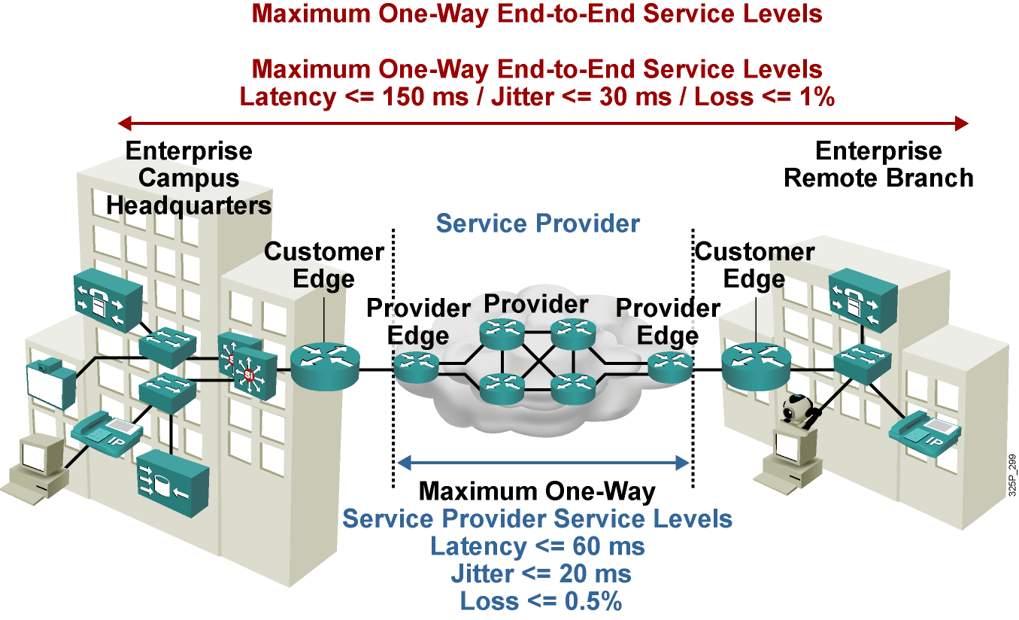
Typical SLA Requirements for Voice
Notes:
To meet the QoS requirements for the different traffic types, both the enterprise and the SP must implement the proper QoS mechanisms to provide end-to-end QoS for the packets traversing an SP IP network.
In this example, the enterprise headquarters and the enterprise branch office are connected to a SP that is providing Layer 3 services.
The SP is providing an SLA for voice traffic with a latency of 60 ms or less, jitter of 20 ms or less, and packet loss of 0.5 percent or less. To meet the end-to-end QoS requirements for voice packets, the entire enterprise network must contribute less than 90 ms of delay—that is, 90 ms (enterprise network) + 60 ms (SP network) <= 150 ms total one-way delay.
Similarly, the jitter in the enterprise network must be less than 10 ms—that is, 10 ms + 20 ms <= 30 ms total one-way jitter.
Finally, packet loss within the enterprise network must be less than 0.5 percent—that is, 0.5 percent + 0.5 percent <= 1.0 percent total packet loss.

Slide 86
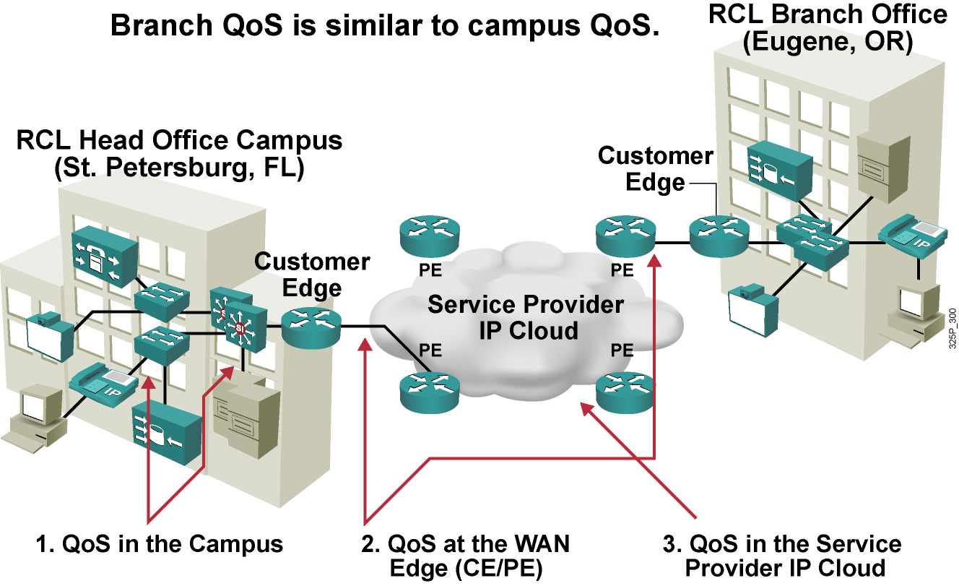
Deploying End-to-End QoS
Notes:
To meet the QoS requirements for different traffic types, both enterprise and SP must implement the proper IP QoS mechanisms to provide end-to-end QoS for the packets traversing a SP network.
This means that at both customer locations, traffic classifications and marking need to be performed (for example, VoIP, data). Depending on the customer connection to the SP, these markings can be mapped into Multiprotocol Label Switching (MPLS) Experimental (EXP) bits, for example, and given priorities. The provider now must guarantee correct transfer over the core to the branch office. The traffic arrives there with the same markings that were set at the head office, allowing again the classification that is needed for end-to-end QoS.

Slide 87
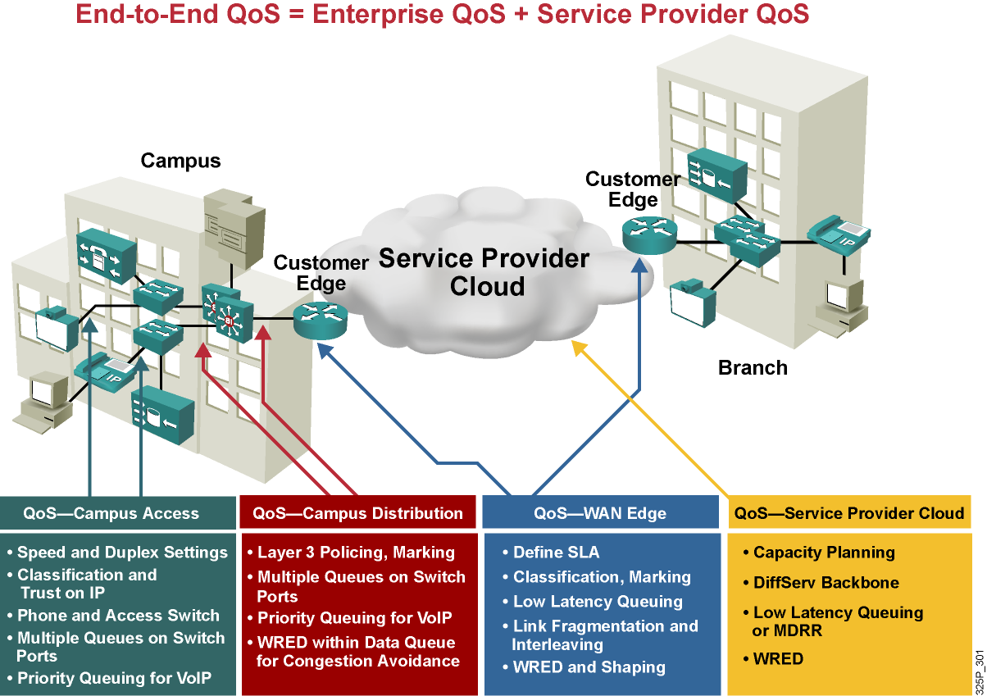
End-to-End QoS Requirements
Notes:
This graphic lists some of the requirements within the building blocks that constitute the end-to-end network.
QoS at the campus access layer focuses on speed and duplex settings, classification, hardware requirements, and queuing.
QoS at the campus distribution layer deals with policing, marking, and congestion avoidance.
Complex QoS configurations typically occur at the WAN edge.
In the IP core (SP cloud), only congestion-management and congestion-avoidance mechanisms are in operation. Key QoS mechanisms used in an IP core include LLQ and weighted random early detection (WRED).

Slide 88

General Guidelines for Campus QoS
Multiple queues are required on all interfaces to prevent transmit queue congestion and drops.
Voice traffic should always go into the highest-priority queue.
Trust the Cisco IP phone CoS setting but not the PC CoS setting.
Classify and mark traffic as close to the source as possible.
Use class-based policing to rate-limit certain unwanted excess traffic.
Notes:
Some of the general guidelines to follow when implementing campus QoS include the following:
Classify and mark the traffic as soon as possible: This principle promotes end-to-end DiffServ PHBs. Sometimes endpoints can be trusted to set class of service (CoS) and differentiated services code point (DSCP) markings correctly, but this practice is not recommended because users can easily abuse provisioned QoS policies if they are permitted to mark their own traffic. For example, if DSCP Expedited Forwarding (EF) receives priority services throughout the enterprise, a user could easily configure the network interface card (NIC) on a PC to mark all traffic to DSCP EF, thus hijacking network priority queues to service non-real-time traffic. Such abuse could easily ruin the service quality of real-time applications (such as VoIP) throughout the enterprise.
Police unwanted traffic flows as close to their sources as possible: There is little sense in forwarding unwanted traffic only to police and drop it at a subsequent node. This is especially the case when the unwanted traffic is the result of denial-of-service (DoS) or worm attacks. Such attacks can cause network outages by overwhelming network device processors with traffic.
Always perform QoS in hardware rather than software when a choice exists: Cisco IOS routers perform QoS in software. This design places additional demands on the CPU, depending on the complexity and functionality of the policy. Cisco Catalyst switches, on the other hand, perform QoS in dedicated hardware ASICs, which does not tax their main CPUs in administering QoS policies. You can therefore apply complex QoS policies at Gigabit and 10 Gigabit Ethernet line speeds in these switches.
Establish proper trust boundaries: For example, at the access layer switches, trust only the IP Phone CoS marking, not the PC CoS marking.
Classify real-time voice and video as higher-priority traffic: Real-time voice and video traffic must be classified at a higher priority than data traffic.
Use multiple queues on the transmit interfaces: Use multiple queues on the transmit interfaces to minimize the potential for dropped or delayed traffic caused by transmit buffer congestion.

Slide 89

Campus Access and Distribution Layer QoS Implementation
Notes:
It is quite rare under normal operating conditions for campus networks to suffer congestion. If congestion does occur, it is usually momentary and not sustained, as at a WAN edge. However, critical applications like VoIP require service guarantees regardless of network conditions.
The only way to provide service guarantees is to enable queuing at any node that has the potential for congestion—regardless of how rarely, in fact, congestion may occur. The potential for congestion exists in campus uplinks because of oversubscription ratios and speed mismatches in campus downlinks (for example, Gigabit Ethernet to Fast Ethernet links). The only way to provision service guarantees in these cases is to enable queuing at these points.
Queuing helps to meet network requirements under normal operating conditions, but enabling QoS within the campus is even more critical under abnormal network conditions, such as DoS and worm attacks. During such conditions, network traffic may increase exponentially until links are fully used. Without QoS, the worm-generated traffic drowns out applications and causes denial of service through unavailability. Enabling QoS policies maintains network availability by protecting and servicing critical applications, such as VoIP, and even best-effort traffic.
So where is QoS required in campus?
Access switches use the following QoS features:
Classification on a per-packet basis
Policing and/or shaping
Fragmentation
Compression
Congestion management
Congestion avoidance
Distribution and core switches use the following QoS features:
Classification on a per-packet basis
Marking
Congestion management
Congestion avoidance
Congestion management
Congestion avoidance

Slide 90

WAN Edge QoS Implementation
Notes:
Routers that terminate the WAN link between the Customer Edge (CE) and the Provider Edge (PE) require a significant configuration effort from the network administrators.
Looking at this figure reveals that administrators need to enable and tune several WAN technologies, such as Frame Relay and ATM, and QoS features, such as LLQ, traffic shaping, and compression, to provide a high level of QoS.

Slide 91


CE and PE Router Requirements for Traffic Leaving Enterprise Network
Output QoS policy on Customer Edge controlled by service provider.
Service provider enforces SLA using the output QoS policy on Customer Edge.
Output policy uses queuing, dropping, and possibly shaping.
Elaborate traffic classification or mapping of existing markings.
May require LFI or cRTP.
Output QoS policy on Customer Edge not controlled by service provider.
Service provider enforces SLA using input QoS policy on Provider Edge.
Input policy uses policing and marking.
Elaborate traffic classification or mapping of existing markings on Provider Edge.
Notes:
First, consider traffic leaving the enterprise network. The QoS requirements on the Customer Edge and Provider Edge routers will differ, depending on whether the SP manages the Customer Edge. Consider two possibilities—a managed Customer Edge and an unmanaged Customer Edge.
For traffic leaving the enterprise Customer Edge router and moving toward the SP edge router, the general QoS requirements on the Customer Edge and Provider Edge routers are listed.
For managed Customer Edge service, the SP will manage and configure the WAN edge output QoS policy on the Customer Edge.
For unmanaged Customer Edge service, the enterprise customer will manage and configure the WAN edge output QoS policy on the Customer Edge.

Slide 92
SP QoS Responsibilities for Traffic Leaving Enterprise Network
Customer Edge Output Policy | Provider Edge Input Policy
Classification, Marking, and Mapping LLQ WRED [Shaping] [LFI or cRTP] | <Not required>
Customer Edge Output Policy | Provider Edge Input Policy
<Irrelevant> | Classification, Marking, and Mapping Policing
Notes:
This graphic shows the SP QoS responsibilities in each of the two scenarios.
For managed Customer Edge service, the SP can enforce the SLA for each traffic class using the output QoS policy on the Customer Edge. For example, you can use LLQ or class-based weighted fair queuing (CBWFQ) to give a maximum bandwidth guarantee to the real-time voice and video traffic class, give a minimum bandwidth guarantee to the data traffic class, and use class-based shaping to provide a maximum rate limit to each data traffic class.
For unmanaged Customer Edge service, because the SP has no control over the Customer Edge, the SP can enforce the SLA for each traffic class only at the input of the Provider Edge router. For example, you can use class-based policing to limit the input traffic rate of the different traffic classes and to re-mark the exceeding traffic.
For an unmanaged Customer Edge, the Customer Edge output policy is managed and configured by the enterprise customer; therefore, it is irrelevant to the SP. At the Provider Edge input interface, the SP has a policy to classify, mark, or map the traffic. The SP also typically implements traffic policing to limit the input traffic rate from the enterprise customer so that the traffic rate does not exceed the contractual rate specified in the SLA.
For a managed Customer Edge, the Customer Edge output policy is managed and configured by the SP. The SP typically has an output policy on the Customer Edge router to classify and mark the traffic exiting the Customer Edge router. LLQ or CBWFQ, along with WRED, are used for congestion management and congestion avoidance. To compensate for speed mismatch or oversubscription, traffic shaping may be required. To improve link efficiency, link fragmentation and interleaving (LFI) and cRTP are used for lower-speed links.

Slide 93


SP Router Requirements for Traffic Leaving SP Network
Service provider enforces SLA using the output QoS policy on Provider Edge.
Output policy uses queuing, dropping, and, optionally, shaping.
May require LFI or cRTP.
No input QoS policy on Customer Edge needed.
Service provider enforces SLA using the output QoS policy on Provider Edge.
Output policy uses queuing, dropping, and, optionally, shaping.
May require LFI or cRTP.
Input QoS policy on Customer Edge irrelevant.
Notes:
For traffic leaving the SP edge router toward the enterprise Customer Edge router, this graphic illustrates the general QoS requirements on the Customer Edge and Provider Edge routers.
For both managed and unmanaged Customer Edge service, the SP can enforce the SLA for each traffic class using the output QoS policy on the Provider Edge.
Queuing and compression can be enabled.
An input policy is not needed.

Slide 94
SP QoS Policies for Traffic Leaving SP Network
Customer Edge
Input Policy
<Not needed>
Provider Edge
Output Policy
LLQ
WRED
[Shaping]
[LFI or cRTP]
Customer Edge
Input Policy
<Irrelevant>
Provider Edge
Output Policy
LLQ
WRED
[Shaping]
[LFI or cRTP]
Notes:
For traffic leaving the SP edge router toward the enterprise Customer Edge router, this graphic illustrates the QoS mechanisms that are commonly implemented at the Provider Edge router.
For both managed and unmanaged Customer Edge service, the SP typically has an output policy on the Provider Edge router using LLQ or CBWFQ, along with WRED, for congestion management and congestion avoidance.
To compensate for speed mismatch or oversubscription, traffic shaping may be required.
To improve the link efficiency, LFI and cRTP are used for lower-speed links.

Slide 95
Managed Customer Edge with Three Service Classes
The service provider in this example is offering managed customer edge service with three service classes:
Real-time (VoIP, interactive video, call signaling): Maximum bandwidth guarantee, low latency, no loss
Critical data (routing, mission-critical data, transactional data, and network management): Minimum bandwidth guarantee, low loss
Best-effort: No guarantees (best effort)
Most DiffServ deployments use a proportional differentiation model:
Rather than allocate absolute bandwidths to each class, service provider adjusts relative bandwidth ratios between classes to achieve SLA differentiation.
Notes:
In this example, the SP is implementing an IP DiffServ backbone and is offering three traffic classes with different SLAs for each:
Real-time (VoIP, interactive video, call signaling): The real-time traffic class is intended for voice traffic, interactive video, and call signaling. This class has a maximum bandwidth limit, low latency, and no loss guarantee.
Critical data (routing, mission-critical data, transactional data, and network management): The critical data traffic class is intended for mission-critical traffic. This class has a minimum bandwidth and a low loss guarantee.
Best-effort: The default (best effort) traffic class is intended for all other traffic. This class has no guarantee.
When you are implementing LLQ or CBWFQ, specify the bandwidth guarantees in kilobits per second, in a percentage of the available bandwidth, or in a percentage of the remaining available bandwidth. Most DiffServ deployments use a proportional differentiation model with the bandwidth guarantees configured as a percentage instead of a fixed bandwidth in kilobits per second.
For example, with three traffic classes, divide the bandwidth allocation as follows:
The real-time (VoIP, interactive video, call signaling) class LLQ can have a maximum bandwidth guarantee of 35 percent of the link bandwidth.
The critical data (routing, mission-critical data, transactional data and network management) class can have a minimum bandwidth guarantee of 40 percent of the link bandwidth after the LLQ is serviced.
The best-effort (default) class can have a minimum bandwidth guarantee of whatever is left—in this case, 25 percent of the link bandwidth after the LLQ is serviced.

Slide 96
WAN Edge Design
Class | Parameters
Real-time (VoIP) | Packet marked EF class and sent to LLQ Maximum bandwidth = 35% of CIR, policed Excess dropped
Real-time (call-signaling) | VoIP signaling (5%) shares the LLQ with VoIP traffic
Critical Data | Allocated 40% of remaining bandwidth after LLQ has been serviced Exceeding or violating traffic re-marked WRED configured to optimize TCP throughput
Best-effort | Best-effort class sent to CBWFQ Allocated 23% of remaining bandwidth after LLQ has been serviced WRED configured to optimize TCP throughput
Scavenger | Best-effort class sent to CBWFQ Whatever is left = 2% of remaining bandwidth
Notes:
For the real-time traffic class, VoIP packets will be marked with EF and go into the LLQ with these parameters:
The LLQ will be policed and have a maximum bandwidth of 35 percent of the committed information rate (CIR).
All excess traffic will be dropped.
The call-signaling traffic (5 percent) will share the LLQ with the VoIP bearer traffic.
For the critical data traffic class, the packets will be marked with Assured Forwarding (AF) 31 and go into the CBWFQ with these class parameters:
The class will be policed and have a minimum bandwidth guarantee of 40 percent of the remaining available bandwidth.
All exceeding and violating traffic will be re-marked and then sent.
WRED will be used on this traffic class to optimize TCP throughput.
For the best-effort traffic class, the packets will be marked with class selector 0 (CS0) and go into the CBWFQ with these class parameters:
The class will be policed and have a minimum bandwidth guarantee of 23 percent of the remaining available bandwidth.
WRED will be used on this traffic class to optimize TCP throughput.
For the scavenger traffic class, the packets will be marked with CS1, with these class parameters:
The class is not policed and has a minimum bandwidth guarantee of 2 percent of the remaining available bandwidth.

Slide 97

CE-to-PE QoS for Frame Relay Access CE Outbound
Provider Edge
Notes:
The traffic policy called “OUT-POLICY” is configured with three SP traffic classes to provide the LLQ or CBWFQ and WRED. Each traffic class bandwidth guarantee is configured using a percentage rather than a fixed bandwidth in kilobits per second.
Both the enterprise voice-bearer and voice-control traffic will be matched using access control list (ACL) 101 and will be serviced by the LLQ with a maximum bandwidth guarantee of 25 percent of the link bandwidth.
The enterprise mission-critical traffic will be matched using ACL 102 and have a minimum guaranteed bandwidth of 75 percent of the remaining available bandwidth after the LLQ has been serviced.
All other traffic from the enterprise will be classified into the default class and have a minimum guaranteed bandwidth of 25 percent of the remaining available bandwidth after the LLQ has been serviced.

Slide 98

CE-to-PE QoS for Frame Relay Access CE Outbound Traffic Shaping
Provider Edge
Notes:
The topology shows that the Customer Edge and Provider Edge link is a Frame Relay link, and traffic shaping is implemented on the PVC using Frame Relay traffic shaping (FRTS).
FRTS is configured using a Frame Relay map class with a CIR of 256 kbps, a committed burst (Bc) of 2560 bits, an excess burst (Be) of 0 (no bursting), and a minimum CIR (mincir) of 256 kbps. The CIR is the rate at which you normally want to send when there is no congestion. The CIR needs to be the remote end-link speed or the actual CIR of the VC. The Bc is the amount that you will send per time interval. The CIR and Bc will be used to compute a committed time interval (Tc), where Tc = Bc / CIR. For FRTS, the command-line interface (CLI) will only allow Bc values that would result in a Tc that is between 10 ms and 125 ms. A recommended value for Tc is 10 ms.
To get a Tc of 10 ms, the Bc should be set to 1/100 of the CIR. The mincir parameter is required, because Cisco IOS software will only allow 75 percent of the mincir to be reserved by the QoS policy applied to the FRTS map class. If the mincir is not configured, it will default to 50 percent of the CIR, which is not desired.
FRF.12 fragmentation and interleaving and cRTP are also enabled within the Frame Relay map class. The fragment size in bytes is set to derive a maximum delay of 10 ms to 15 ms. The fragment size should be the same on both ends.
The OUT-POLICY traffic policy is applied within the Frame Relay map class.

Slide 99

CE-to-PE QoS for Frame Relay Access PE Inbound
Notes:
The output shows the QoS configurations on the ingress
Provider Edge router inbound interface to implement the required QoS policy for each of the three SP traffic classes.
On the Provider Edge, a traffic policy called “IN-POLICY” is configured to provide the required class-based policing. For the premium class, the rate limit is set to 25 percent of the link bandwidth. All exceeding premium-class traffic is dropped. For the business class, the rate limit is set to 38 percent of the link bandwidth. All exceeding and violating business-class traffic is re-marked with a higher drop probability and then sent. The default class is not policed.
The IN-POLICY traffic policy is applied within the Frame Relay map class.

Slide 100
What Is CoPP?
The Control Plane Policing (CoPP) feature allows users to configure a QoS filter that manages the traffic flow of control plane packets to protect the control plane against DoS attacks.
CoPP has been available since Cisco IOS Software Release 12.2(18)S.
A Cisco router is divided into four functional planes:
Data plane
Management plane
Control plane
Service plane
Any service disruption to the route processor or the control and management planes can result in business-impacting network outages.
Notes:
Infrastructure attacks are becoming increasingly common, highlighting the need for infrastructure protection. The Control Plane Policing (CoPP) feature allows users to configure a QoS filter that manages the traffic flow of control plane packets to protect the control plane of Cisco IOS routers and switches against reconnaissance and DoS attacks. In this way, the control plane can help maintain packet forwarding and protocol states despite an attack or a heavy traffic load on the router or switch.
By protecting the Route Processor, CoPP helps ensure router and network stability during an attack. For this reason, a best-practice recommendation is to deploy CoPP as a key protection mechanism.
The CoPP feature was introduced in Cisco IOS Software Release 12.2(18)S.
A router has four functional components or planes:
Data plane
Management plane
Control plane
Services plane
The vast majority of traffic travels through the router via the data plane; however, the Route Processor must handle certain packets, such as routing updates, keepalives, and network management, referred to as control and management plane traffic.
Because the Route Processor is critical to network operations, any service disruption to the Route Processor or the control and management planes can result in business-impacting network outages. A DoS attack targeting the Route Processor, which can be perpetrated either inadvertently or maliciously, typically involves high rates of punted traffic that result in excessive CPU use on the Route Processor itself. This type of attack, which can be devastating to network stability and availability, may display the following symptoms:
High Route Processor CPU use (near 100 percent)
Loss of line protocol keepalives and routing protocol updates, leading to route flaps and major network transitions
Slow or completely unresponsive interactive sessions via the command-line interface (CLI) due to high CPU use
Route Processor resource exhaustion, such as memory and buffers that are unavailable for legitimate IP data packets
Packet queue backup, which leads to indiscriminate drops (or drops due to lack of buffer resources) of other incoming packets.

Slide 101
CoPP Deployment
To deploy CoPP, take the following steps:
Define a packet classification criteria.
Define a service policy.
Enter control-plane configuration mode.
Apply QoS policy.
Use MQC for configuring CoPP.
Notes:
CoPP leverages the MQC to define traffic classification criteria and to specify configurable policy actions for the classified traffic. Traffic of interest must first be identified via class maps, which are used to define packets for a particular traffic class. After classification, enforceable policy actions for the identified traffic are created with policy maps. The control-plane global command allows the control plane service policies to be attached to control plane itself.
There are four steps required to configure CoPP:
Define a packet classification criteria.
Define a service policy.
Enter control-plane configuration mode.
Apply QoS policy.
The MQC provides a flexible interface for creating service policies. Traffic can be identified via the class-map command and be dropped or permitted access to the route processor.

Slide 102
CoPP Example
access-list 140 deny tcp host 10.1.1.1 any eq telnet
access-list 140 deny tcp host 10.1.1.2 any eq telnet
access-list 140 permit tcp any any eq telnet
!
class-map telnet-class
match access-group 140
!
policy-map control-plane-in
class telnet-class
police 80000 conform transmit exceed drop
!
control-plane slot 1
service-policy input control-plane-in
Notes:
The example shows how to apply a QoS policy for aggregate control plane services to Telnet traffic transmitted from the control plane.
The example shows how to configure rate limiting (on input) for distributed control plane traffic.
QoS policy is applied to the data plane to perform distributed control plane services on packets destined for the control plane from the interfaces on the line card in slot 1. Trusted hosts are configured with source addresses 10.1.1.1 and 10.1.1.2 to forward Telnet packets to the control plane without constraint, while allowing all remaining Telnet packets that enter through slot 1 to be policed at the specified rate.
The MQC is used to match the traffic, limit the traffic, and apply the policy to the control plane.

